Slide 1
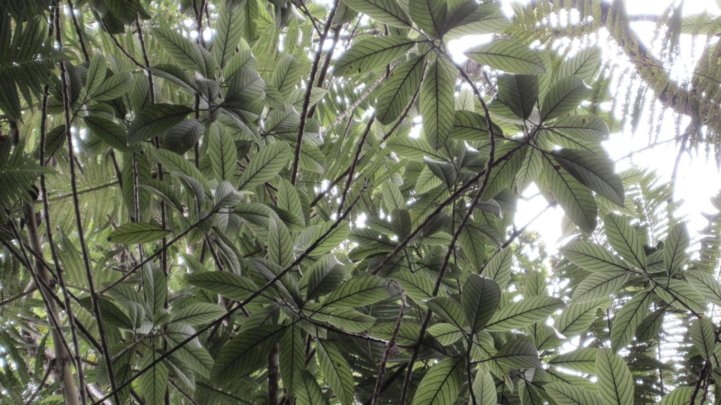
Vegetation Protocols Orientation

Slide 2
Focal Terrestrial Plant Communities
Community Plots
Established Invasive Species
Invasive Transects
Early Detection of Invasive Species
New Invasives

Slide 3
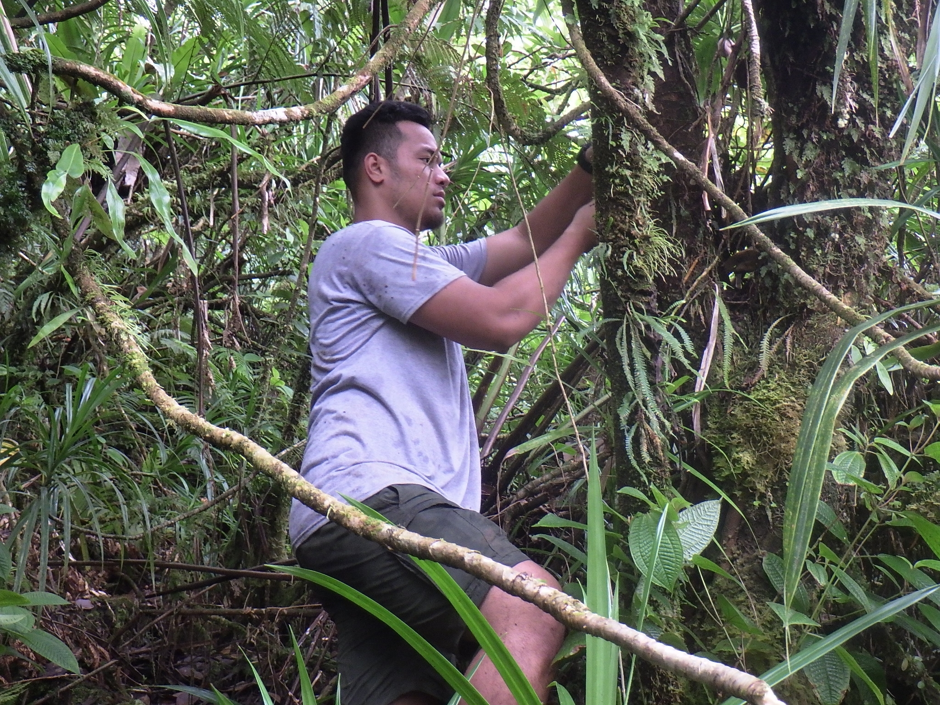

Slide 4
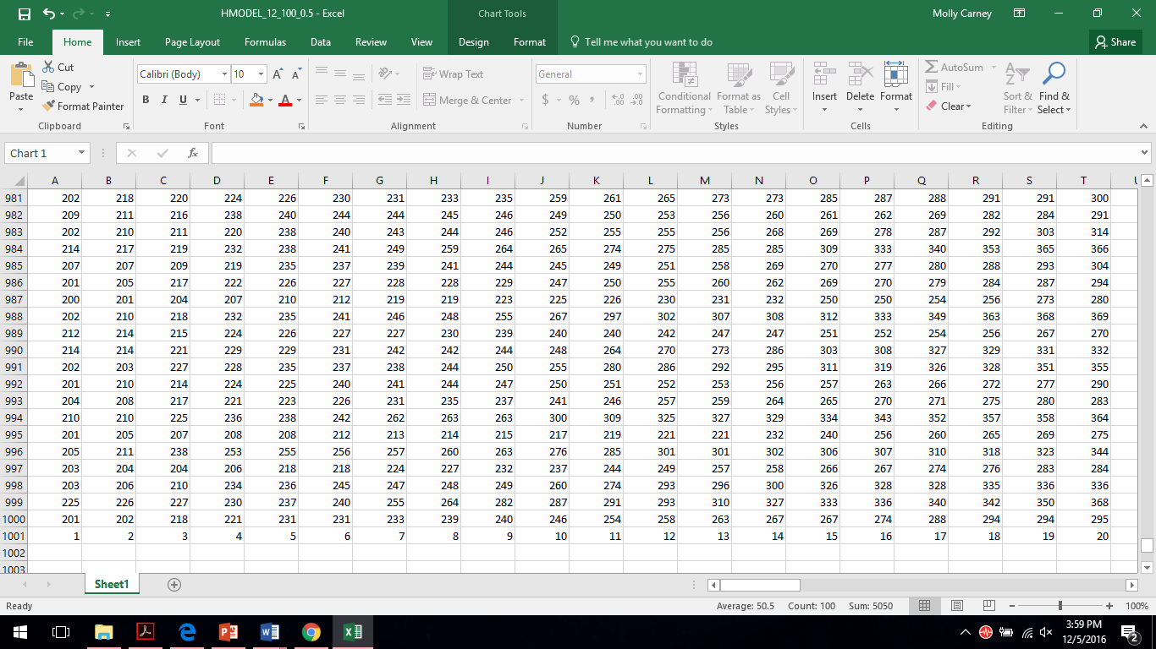

Training - SOPs, rules, methodology
Getting From Here
To Here
This Photo by Unknown Author is licensed under CC BY-SA

Slide 5
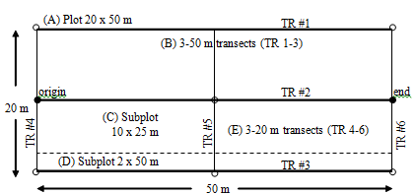
Species richness
Abundance
Density by size
class

Slide 6
Vegetation Attribute | Plot Size (m) | Summary Statistics (Means & Var)
Presence/Absence | 20 x 50 10 x 20 | Total Species Richness* Native Species Richness* Nonnative Species Richness*Ratio (Native Richness:Total Richness)*
Understory Cover (<1 m; 1-2 m) | 20 x 50 10 x 20 | % cover for some species and life forms, native and nonnative (<1 m)* % cover for some species and life forms, native and nonnative (1-2 m)*
Large Tree Density (DBH ≥10 cm) | 20 x 50 | # Trees/ha (all trees)* # Trees/ha (for some species)* # Native Trees/ha* # Nonnative Trees/ha* # Snags/ha* # Native Snags/ha* # Nonnative Snags/ha* # Boles/Tree (all trees) # Boles/Native Tree # Boles/Nonnative Tree DBH (all trees) DBH (for some species)* Percent of Trees with Damage Percent of Natives with Damage Percent of Nonnatives with Damage Percent of Trees Flowering/Fruiting Percent of Natives Flowering/Fruiting Percent of Nonnatives Flowering or Fruiting
Tree Canopy Height | 20 x 50 | Canopy Height
Tree Fern Density (Diameter ≥10 cm) | 10 x 25 | # Tree Ferns/ha* # Tree Fern Snags/ha* Diameter
Tree Fern Subcanopy Height | 10 x 25 | Subcanopy Height
Vegetation Attribute | Plot Size (m) | Summary Statistics (Means & Var)
Sapling Density | 10 x 25 | # Saplings/ha (all trees)* # Saplings/ha (for some species)* # Native Saplings/ha* # Nonnative Saplings/ha* # Dead Saplings/ha* # Dead Native Saplings/ha* # Dead Nonnative Saplings/ha* % Saplings with Damage % Native Saplings with Damage % Nonnative Saplings
Seedling Density | 2 x 50 | # Seedlings/ha* # Native Seedlings/ha* # Nonnative Seedlings/ha* % Seedlings in terrestrial substrate* % Native seedlings in terrestrial substrate* % Nonnative seedlings in terrestrial substrate*
Shrub Density | 2 x 50 | # Shrubs/ha* # Native Shrubs/ha* # Nonnative Shrubs/ha* % shrubs in terrestrial substrate* % shrubs at maturity* % Native shrubs in terrestrial substrate % Native shrubs at maturity % Nonnative shrubs in terrestrial substrate % Nonnative shrubs at maturity
Tree Fern Juvenile Density | 2 x 50 | # tree fern juveniles/ha (overall)* # tree fern juveniles/ha (some species)* % Native tree fern juveniles (if possible) % Nonnative tree fern juveniles (if possible) % tree fern juveniles in terrestrial sub. % Native tree fern juveniles in terrestrial substrate
Coarse Woody Debris (CWD) | 90 m of Transect; 70 m of Transect | # woody logs/ha # tree fern logs/ha Diameter woody logs Diameter tree fern logs % CWD
Vegetation Attribute | Transect | Summary Statistics (Means & Var)
Invasive Species Richness | 5 x 20 or 5 x 10 plots along transect | Count of invasive species per plot
Frequency | 5 x 20 or 5 x 10 plots along transect | No. or % of plots with presence of species, life forms, or other groupings
Cover Class | 5 x 20 or 5 x 10 plots along transect | No. or % of plots with a particular cover class for a species
…and photo data

Slide 8

Species Identification
Each year ~150-300 species to know and identify
So far 800+ unique species total
50+ species in one 20x50 m plot.

Slide 9
Training & Experience
3 weeks for crewmember training
1 season to be experienced crew leader
accuracy & efficiency

Slide 10
Year | Park Unit
2021 | HAVO
2022 | HAVO
 | KAHO
2023-24 | HALE
 | KALA
2025 | NPSA
2026 | WAPA
 | AMME
3rd Cycle
2010-2014 (1st)
2015-2019 (2nd)
7 Parks

Slide 11
Year | Park Unit | Plant Community
2021 | HAVO | Wet Forest
 |  | Wet Forest
2022 | HAVO | Wet Forest
 |  | Subalpine
 | KAHO | Coastal Strand
2023-24 | HALE | Wet Forest
 |  | Subalpine
 | KALA | Wet Forest
 |  | Coastal Strand
 |  | Coastal Strand
2025 | NPSA | Wet Forest
 |  | Wet Forest
2026 | WAPA | Limestone Forest
 | AMME | Mangrove Forest
5 Plant Communities

Slide 12
Year | Park Unit | Plant Community
2021 | HAVO | Wet Forest
 |  | Wet Forest
2022 | HAVO | Wet Forest
 |  | Subalpine
 | KAHO | Coastal Strand
2023-24 | HALE | Wet Forest
 |  | Subalpine
 | KALA | Wet Forest
 |  | Coastal Strand
 |  | Coastal Strand
2025 | NPSA | Wet Forest
 |  | Wet Forest
2026 | WAPA | Limestone Forest
 | AMME | Mangrove Forest
5 Plant Communities

Slide 13
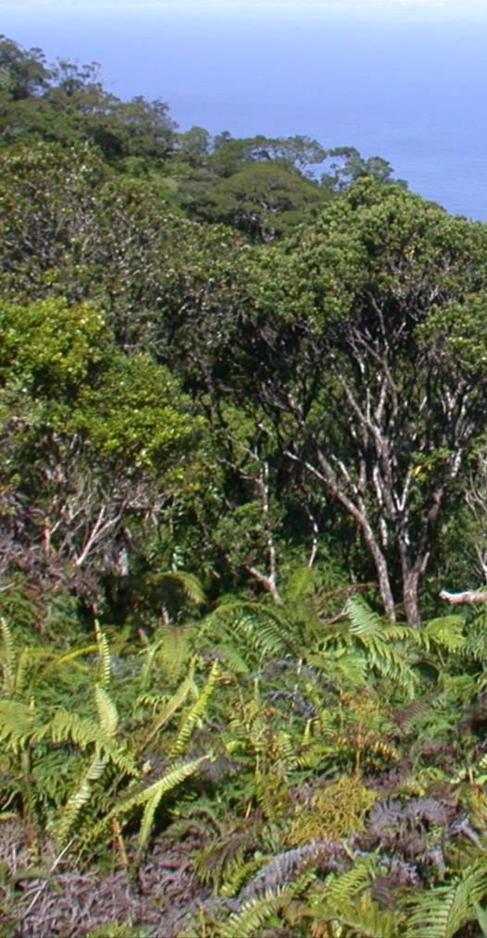
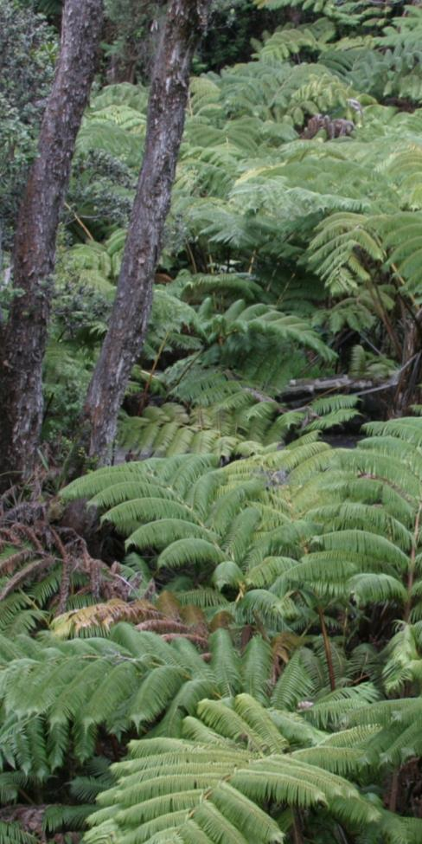
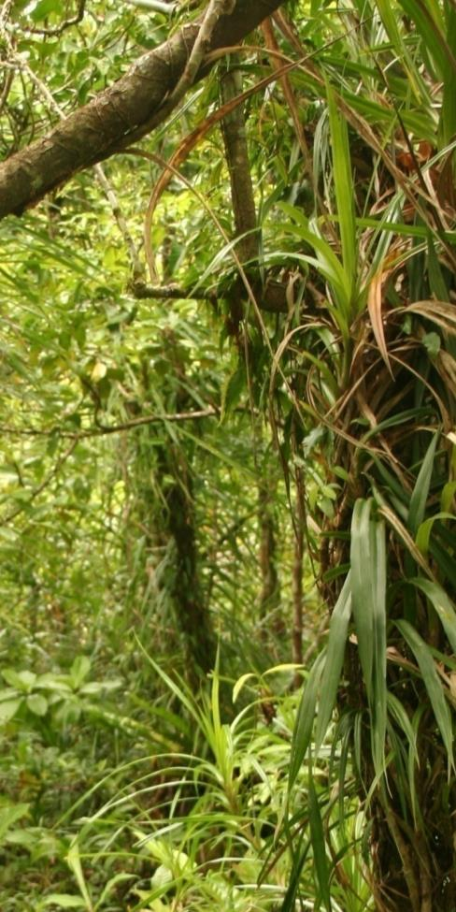
Wet Forest
HAVO, HALE, NPSA & KALA
Hawaiʻi Volcanoes NP (2010-2016; 160 plots)
Haleakalā NP (2012-2018; 46+ plots)
Kalaupapa NHP (2012-2017; 60 plots)
NP of American Samoa (2013; 41 plots)
Notes:
>200 wet forest 20x50m plots monitored across 5 islands

Slide 14
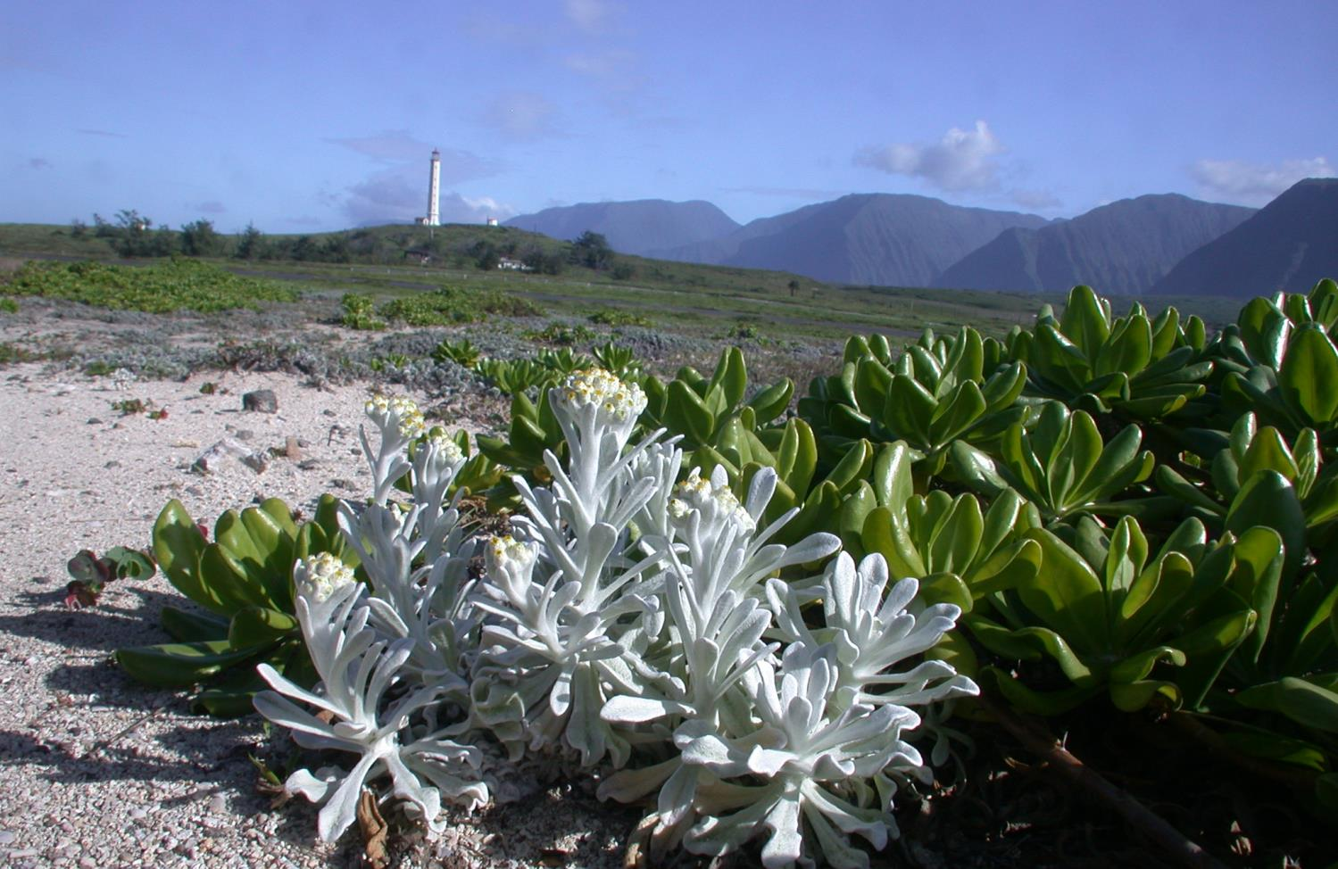
Coastal Strand
KALA & KAHO
Kaloko-Honokōhau NHP (2011-2016; 30 plots)
Kalaupapa NHP (2012-2017; 60 plots)
Notes:
90 coastal strand plots monitored across two islands

Slide 15
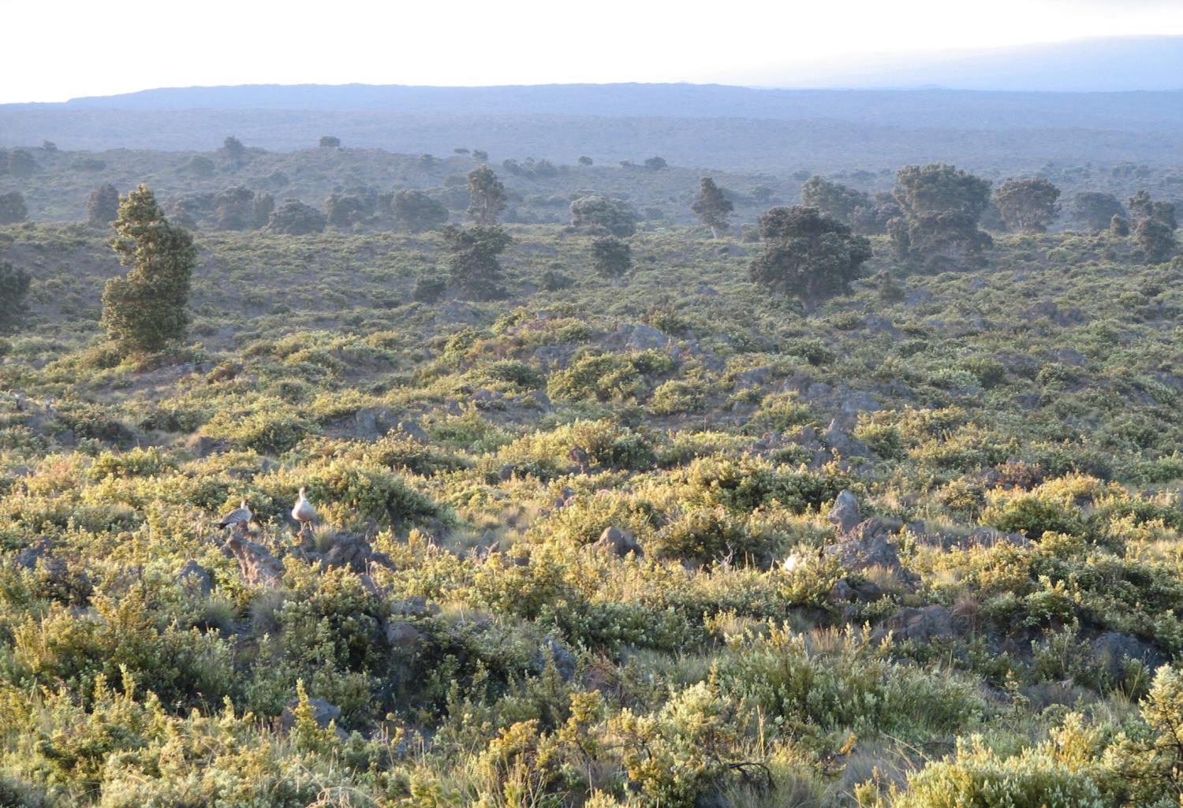
Subalpine Shrubland
HAVO & HALE
Hawaiʻi Volcanoes NP (2011-2016; 60 plots)
Haleakalā NP (2012-2018; 59+ plots)

Slide 16
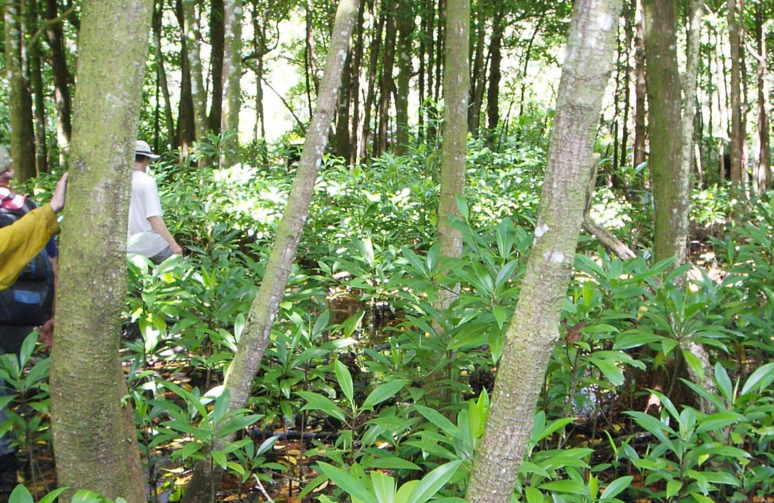
Mangrove Wetland
AMME
American Memorial Park (2014; 10 plots)

Slide 17
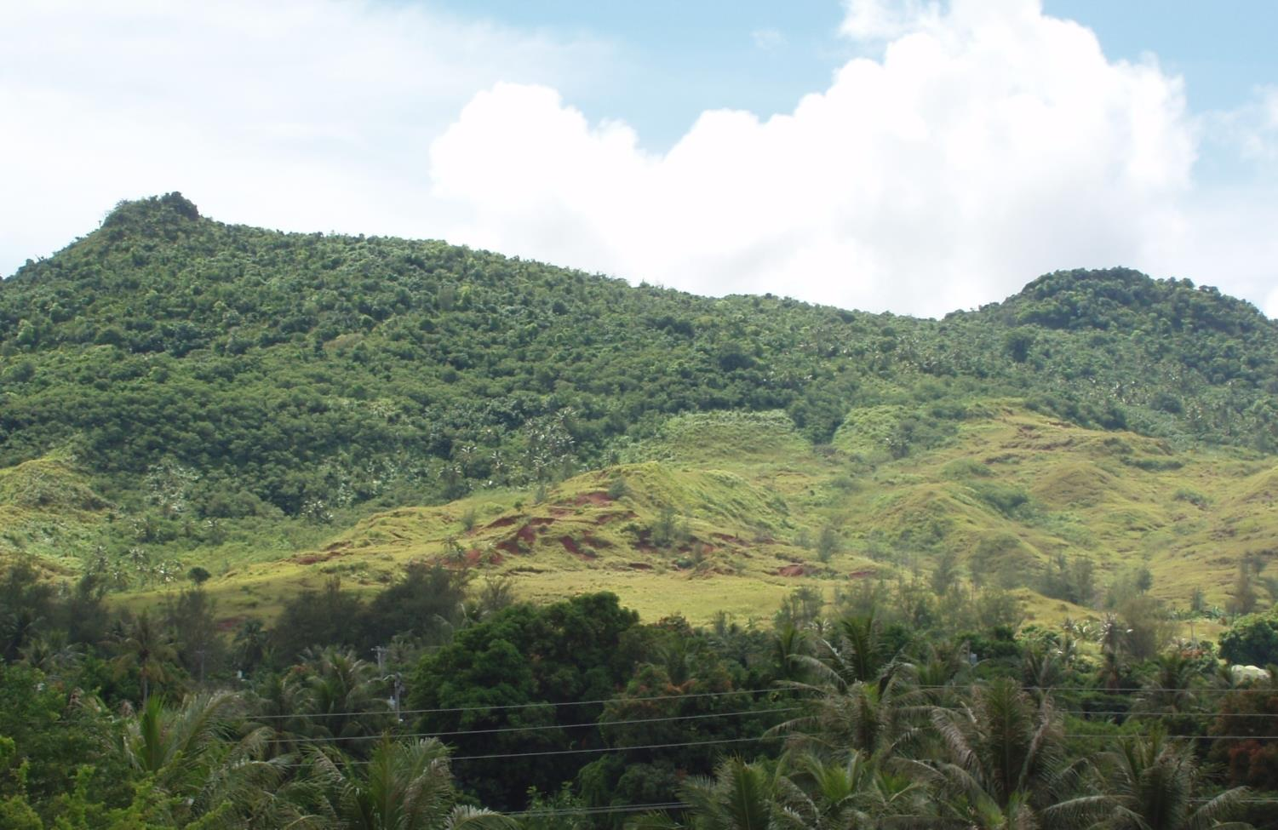
Limestone Forest
WAPA
War in the Pacific NHP (2014; 15 plots)

Slide 18
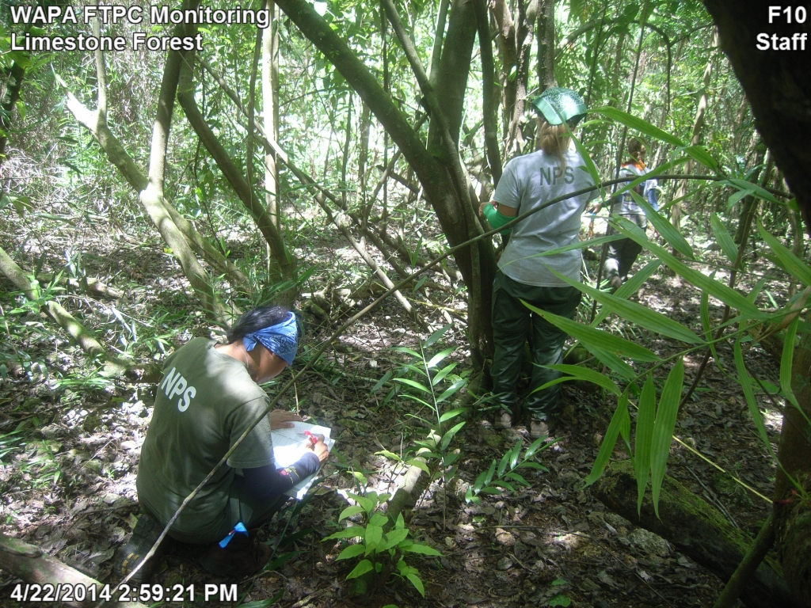
Limestone Forest

Slide 19
Year | Park Unit | Plant Community | Sampling Frame
2021 | HAVO | Wet Forest | ʻŌlaʻa
 |  | Wet Forest | Nāhuku/East Rift
2022 | HAVO | Wet Forest | Kahuku
 |  | Subalpine | Mauna Loa
 | KAHO | Coastal Strand | Kaloko-Honokohau
2023-24 | HALE | Wet Forest | Kīpahulu District
 |  | Subalpine | Haleakalā
 | KALA | Wet Forest | Puʻu Aliʻi
 |  | Coastal Strand | Kalawao
 |  | Coastal Strand | Hoʻolehua
2025 | NPSA | Wet Forest | Tutuila
 |  | Wet Forest | Ta‘ū
2026 | WAPA | Limestone Forest | Guam
 | AMME | Mangrove Forest | Muchot
14 Sampling
Frames

Slide 20
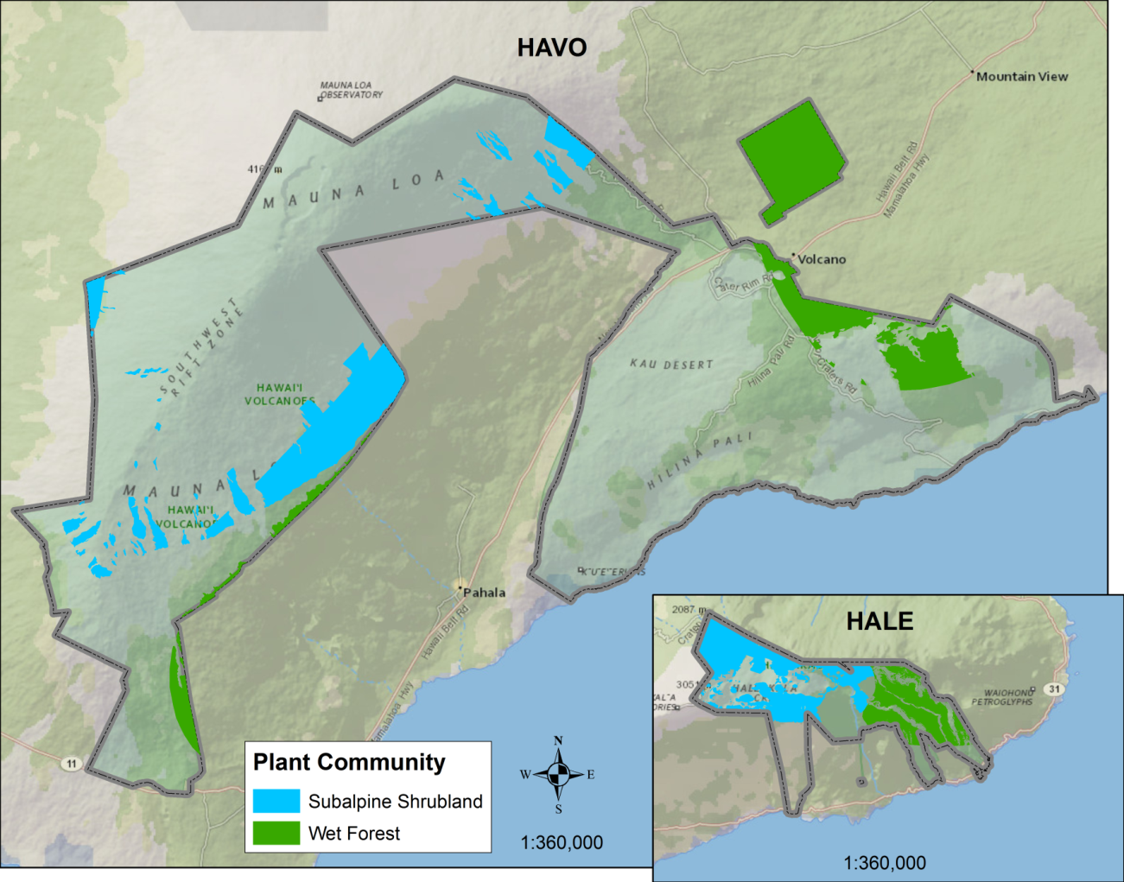
Notes:
Many of the results that follow are better summarized at a smaller spatial scale then these two plant communities.
So I’m going to use these zones circled here on this map. And these zones are part of the hierarchical sampling design described in our protocols.
The next slide we’ll examine non-native richness in each one of these zones.

Slide 21
Notes:
Many of the results that follow are better summarized at a smaller spatial scale then these two plant communities.
So I’m going to use these zones circled here on this map. And these zones are part of the hierarchical sampling design described in our protocols.
The next slide we’ll examine non-native richness in each one of these zones.

Slide 22
Year | Park Unit | Plant Community | Sampling Frame
2021 | HAVO | Wet Forest | ʻŌlaʻa
 |  | Wet Forest | Nāhuku/East Rift
2022 | HAVO | Wet Forest | Kahuku
 |  | Subalpine | Mauna Loa
 | KAHO | Coastal Strand | Kaloko-Honokohau
2023-24 | HALE | Wet Forest | Kīpahulu District
 |  | Subalpine | Haleakalā
 | KALA | Wet Forest | Puʻu Aliʻi
 |  | Coastal Strand | Kalawao
 |  | Coastal Strand | Hoʻolehua
2025 | NPSA | Wet Forest | Tutuila
 |  | Wet Forest | Ta‘ū
2026 | WAPA | Limestone Forest | Guam
 | AMME | Mangrove Forest | Muchot
14 Sampling
Frames

Slide 23
Year | Park Unit | Plant Community | Sampling Frame | Plots | Transects
2021 | HAVO | Wet Forest | ʻŌlaʻa | 30 | 20
 |  | Wet Forest | Nāhuku/East Rift | 30 | 20
2022 | HAVO | Wet Forest | Kahuku | 30 | 30
 |  | Subalpine | Mauna Loa | 30 | 20
 | KAHO | Coastal Strand | Kaloko-Honokohau | 15 | NA
2023-24 | HALE | Wet Forest | Kīpahulu District | 30 | 20
 |  | Subalpine | Haleakalā | 30 | 20
 | KALA | Wet Forest | Puʻu Aliʻi | 30 | NA
 |  | Coastal Strand | Kalawao | 20 | 9
 |  | Coastal Strand | Hoʻolehua | 20 | 16
2025 | NPSA | Wet Forest | Tutuila | 30 | NA
 |  | Wet Forest | Ta‘ū | 30 | NA
2026 | WAPA | Limestone Forest | Guam | 15 | NA
 | AMME | Mangrove Forest | Muchot | 10 | 8
Community
Plots
Invasive
Transects

Slide 24
Sample Size: Why 30 plots, 20 transects?
Appendix C of protocol: Precision, Power and Sample Size
Precision estimates from 6 studies across PACN sampling frames.
Sample size to detect 30% change:
Low (n = <30)
Species Richness
Native Cover
Native Woody Tree Density
Large (n = >30)
Other grouped cover and density parameters
Very Large (n = 100+)
Species cover and density parameters

Slide 25
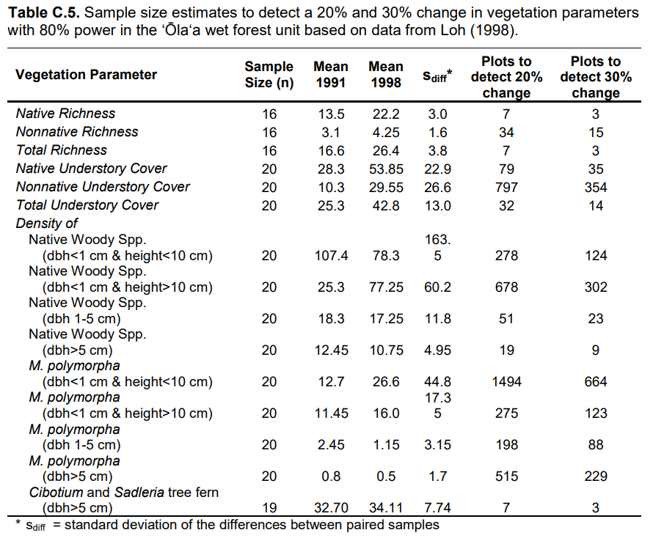
Shrub density
'Ohi'a seedlings
'Ohi’a small/medium

Slide 26
Sample Size: Why 30 plots, 20 transects?
“The recommended sample size of 30 plots per sampling frame is based on the maximum of what I&M and the parks can feasibly survey during a sampling year due to logistical and financial constraints.”

Slide 27
Preservation
Access
Certification Documenting / cataloging
Fieldwork
Cleaning QA/QC
Data Entry
Data Analysis
Planned Analyses on Vital Signs per se
Information for Park Resource Management
Better Park Condition for Future Generations
Unplanned Analyses driven by specific management issues
Notes:
Connecting the workflow with R.

Slide 28
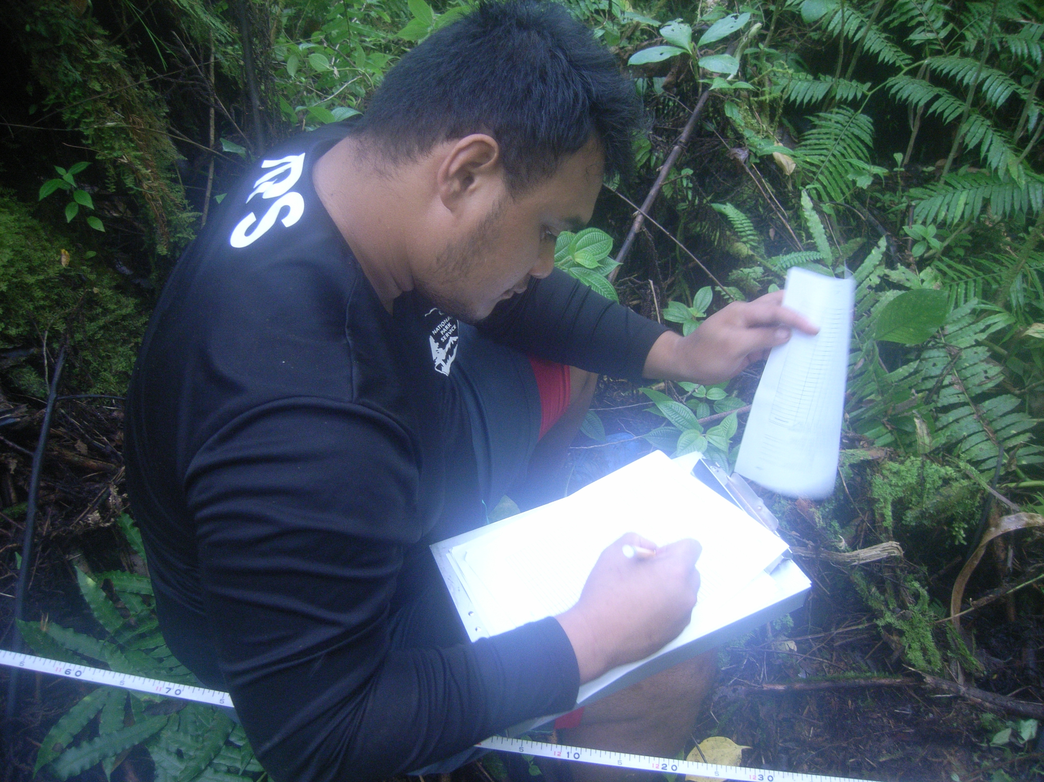
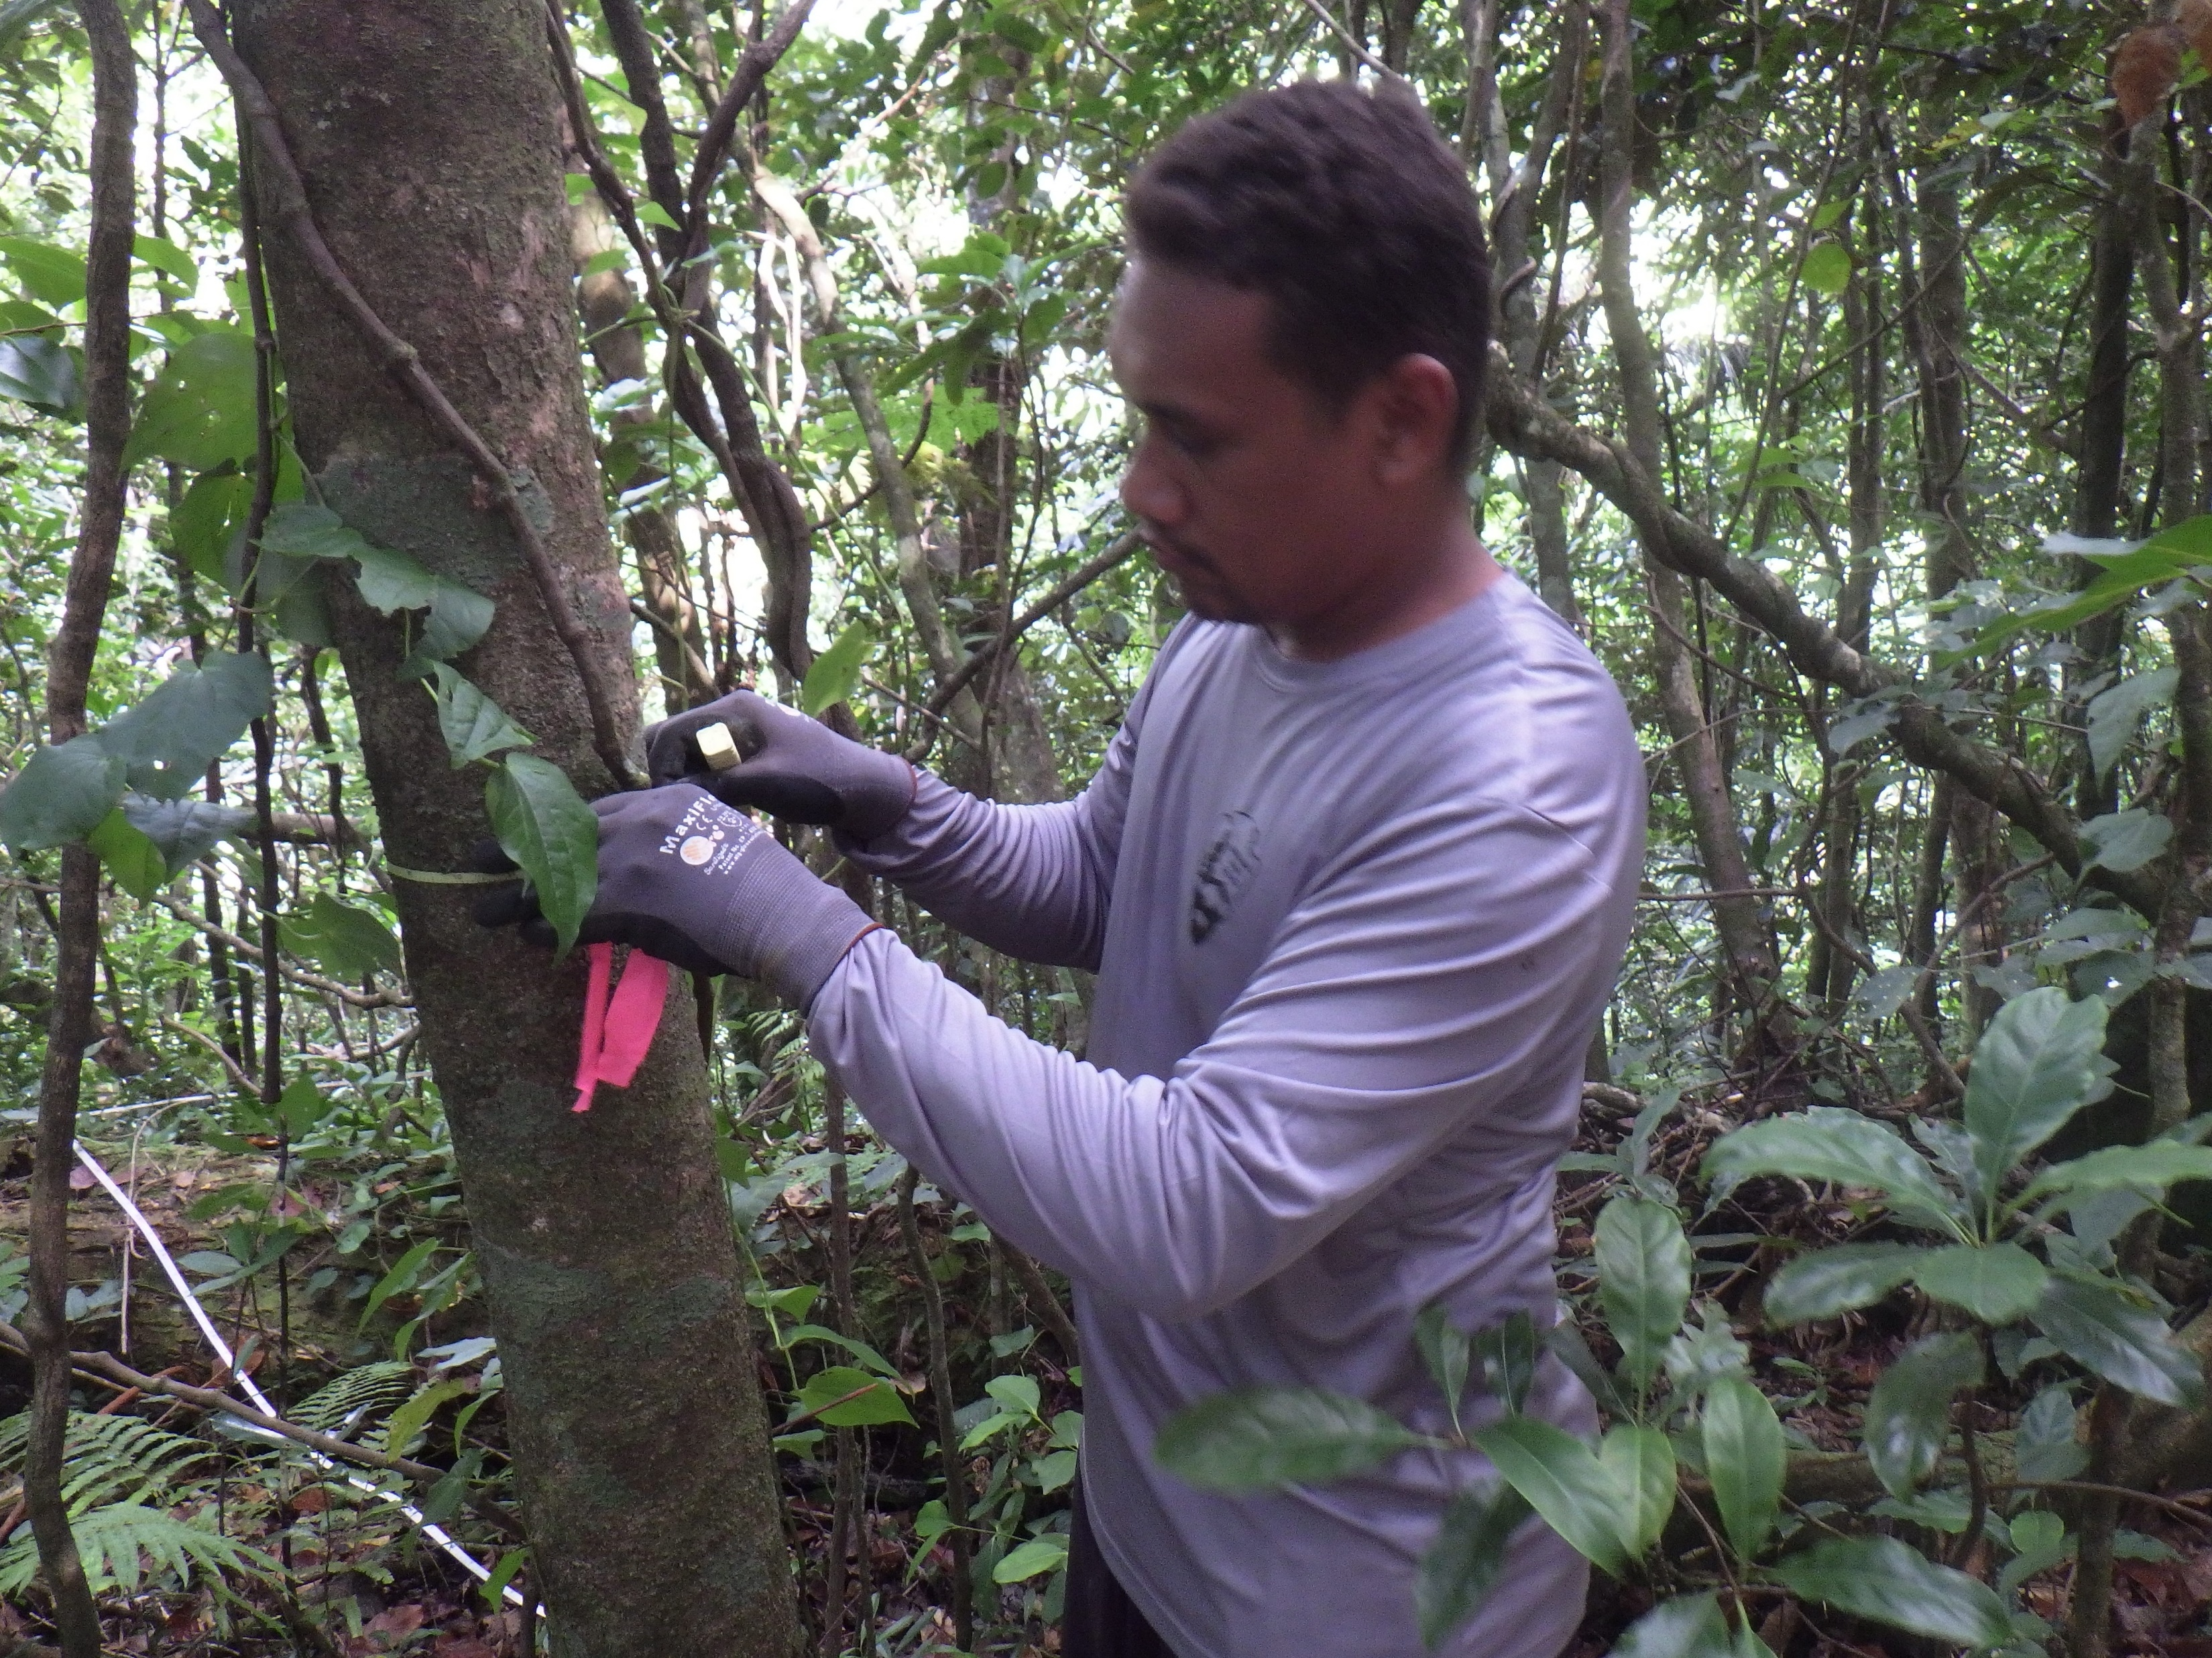
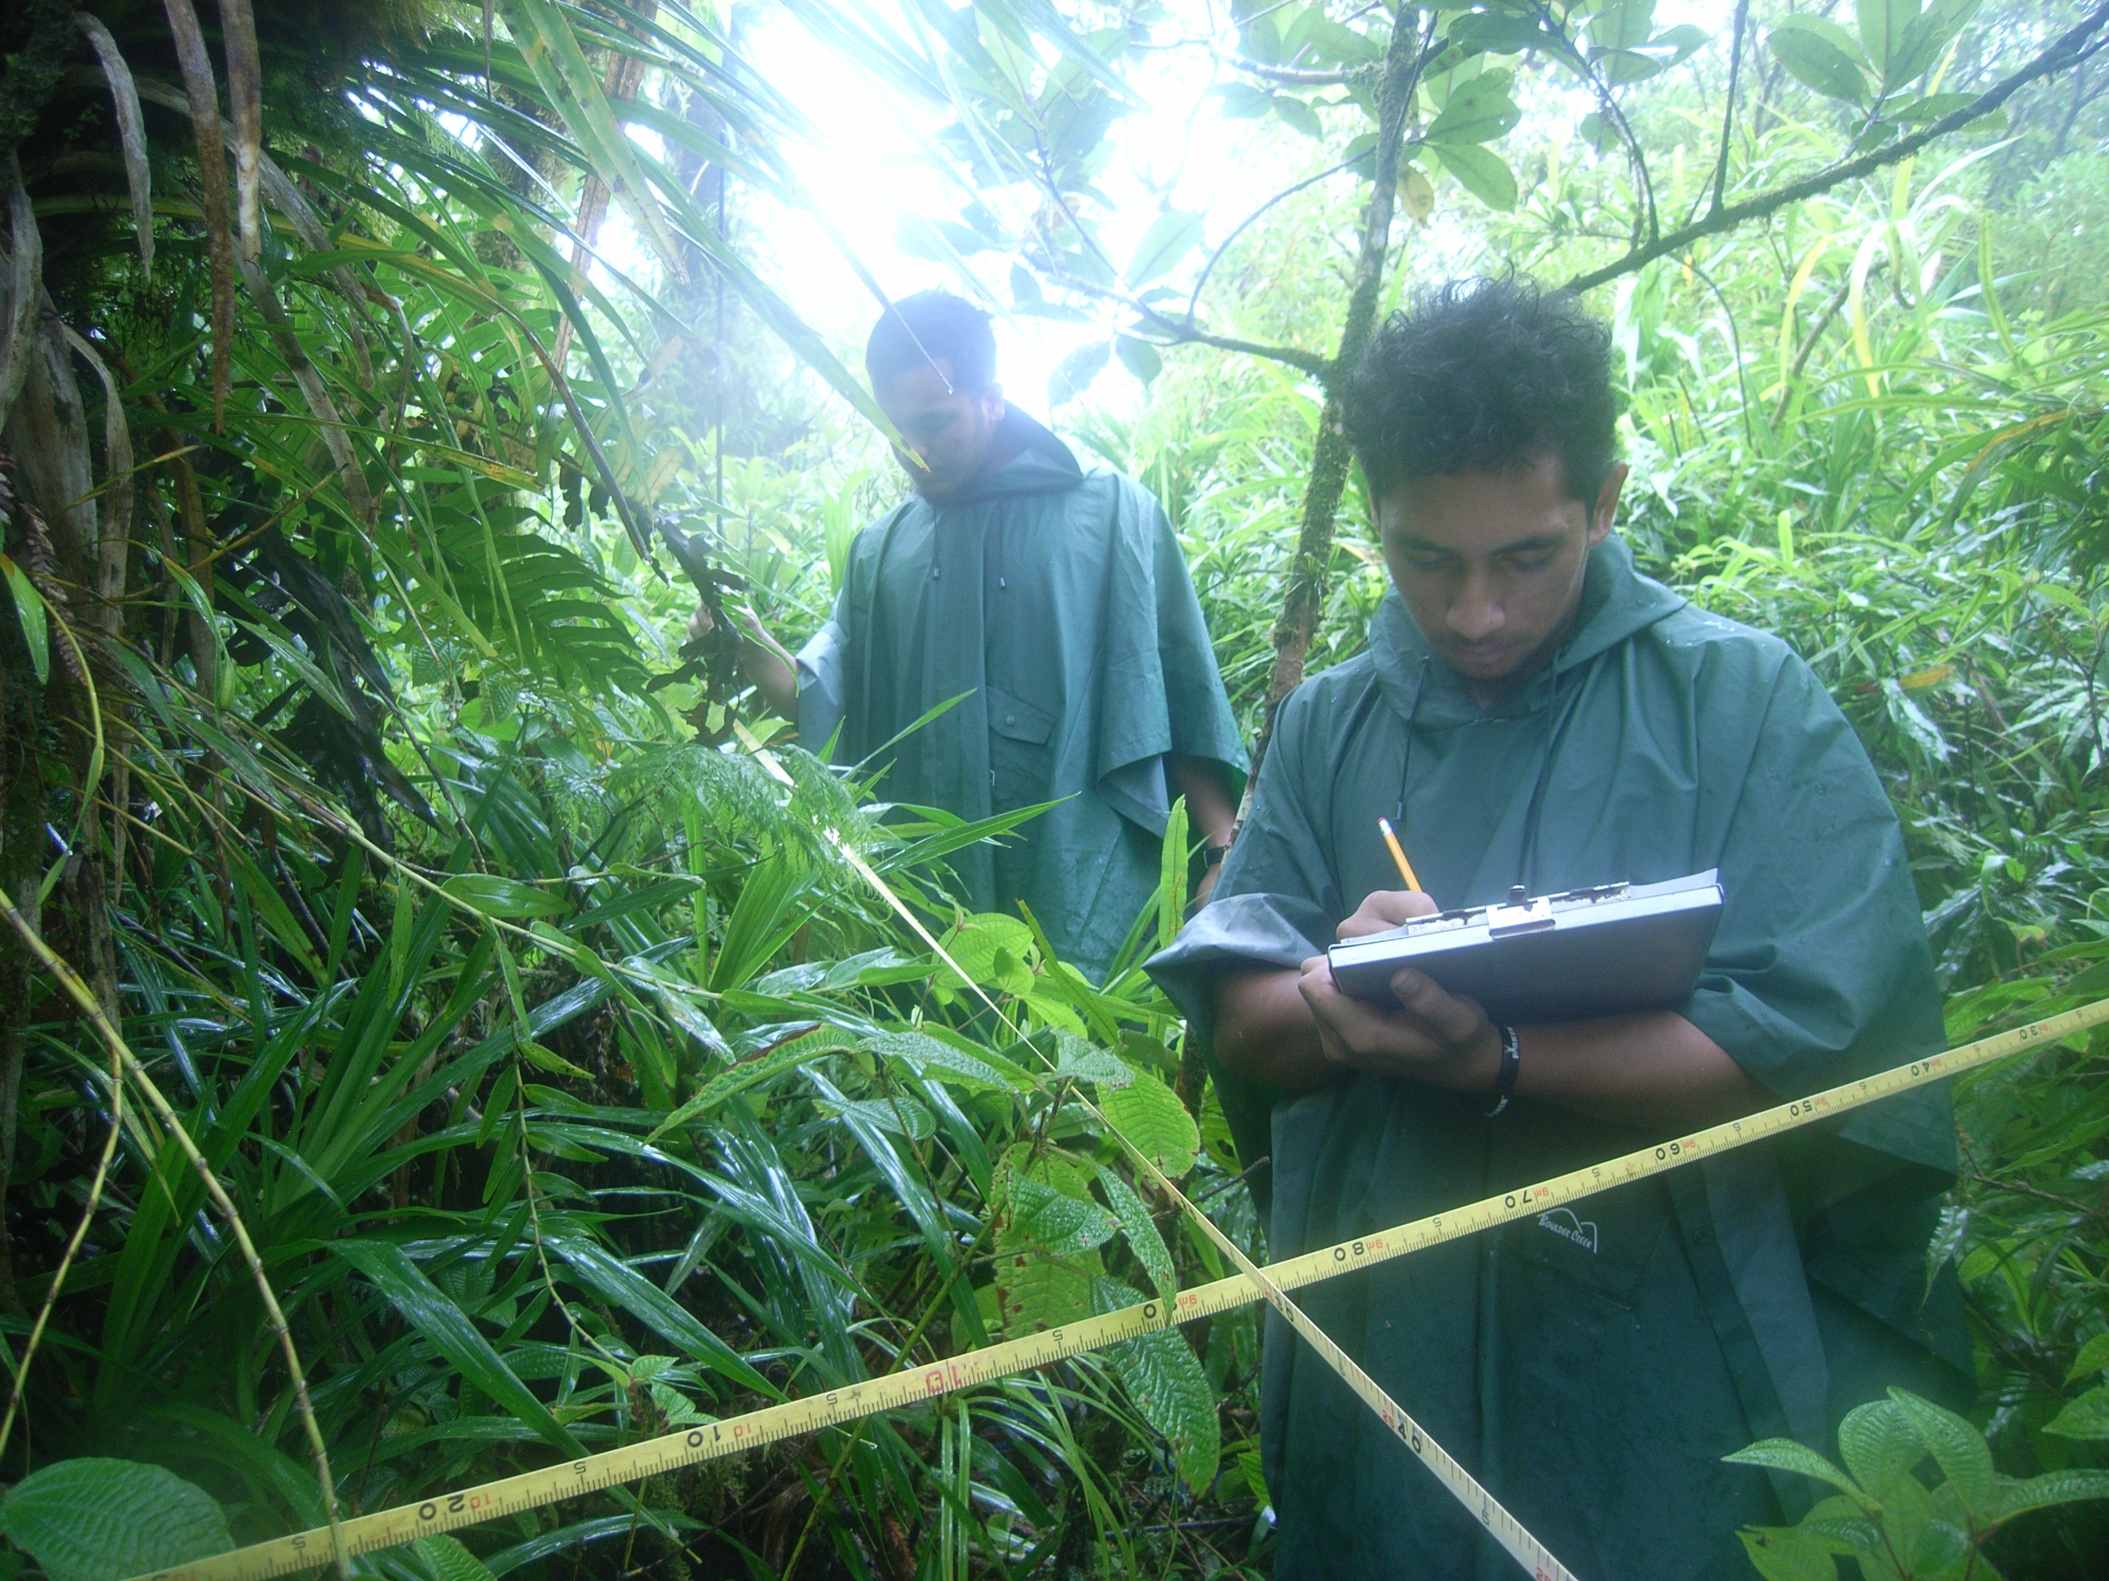
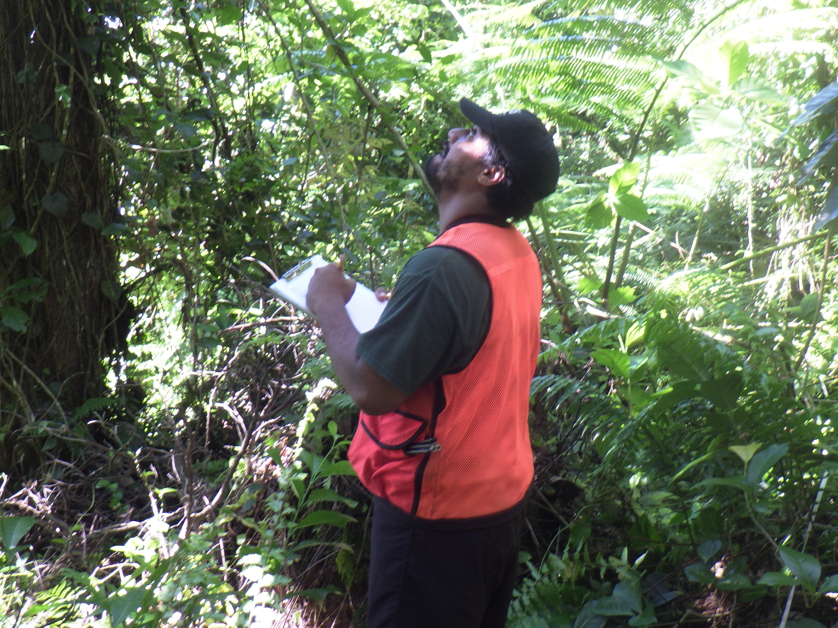
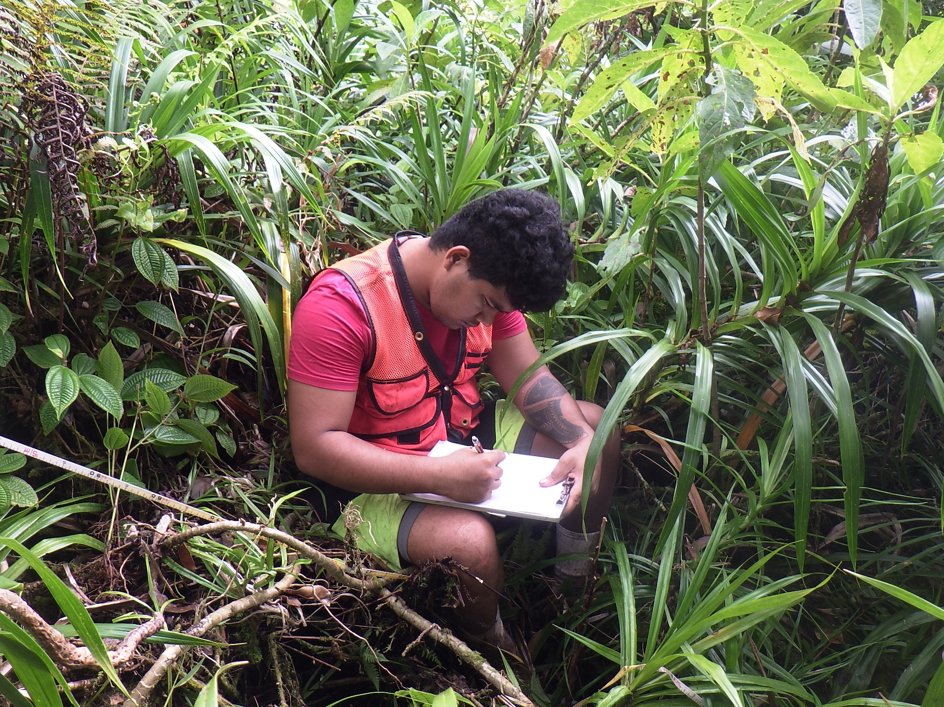
2018
Notes:
What are they writing down?

Slide 29
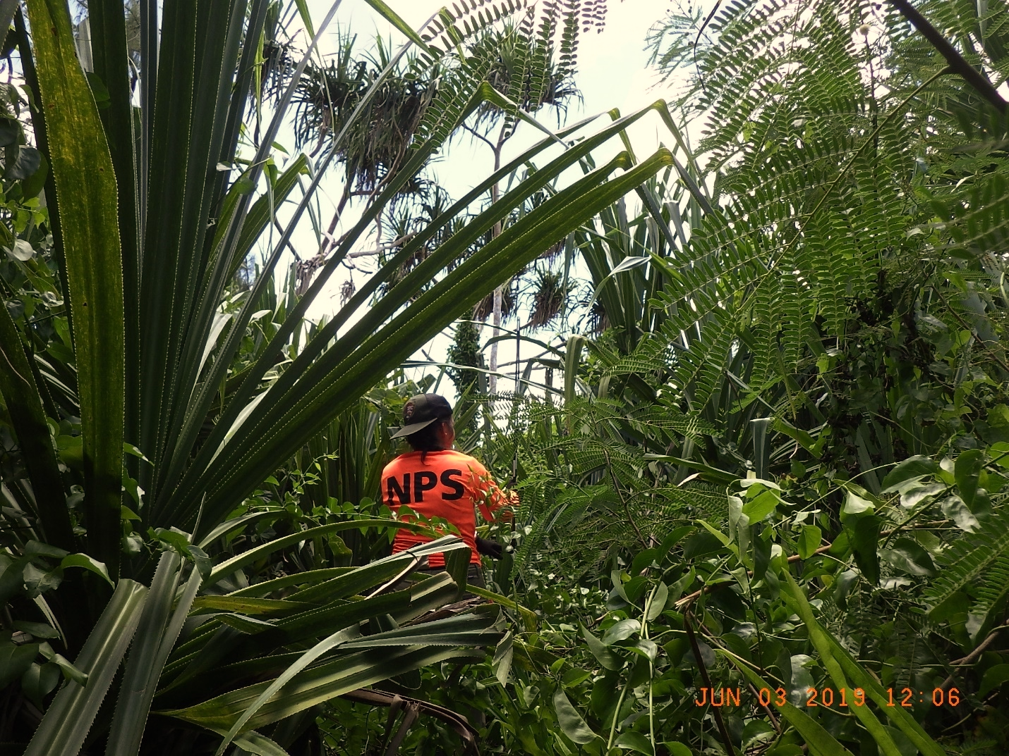
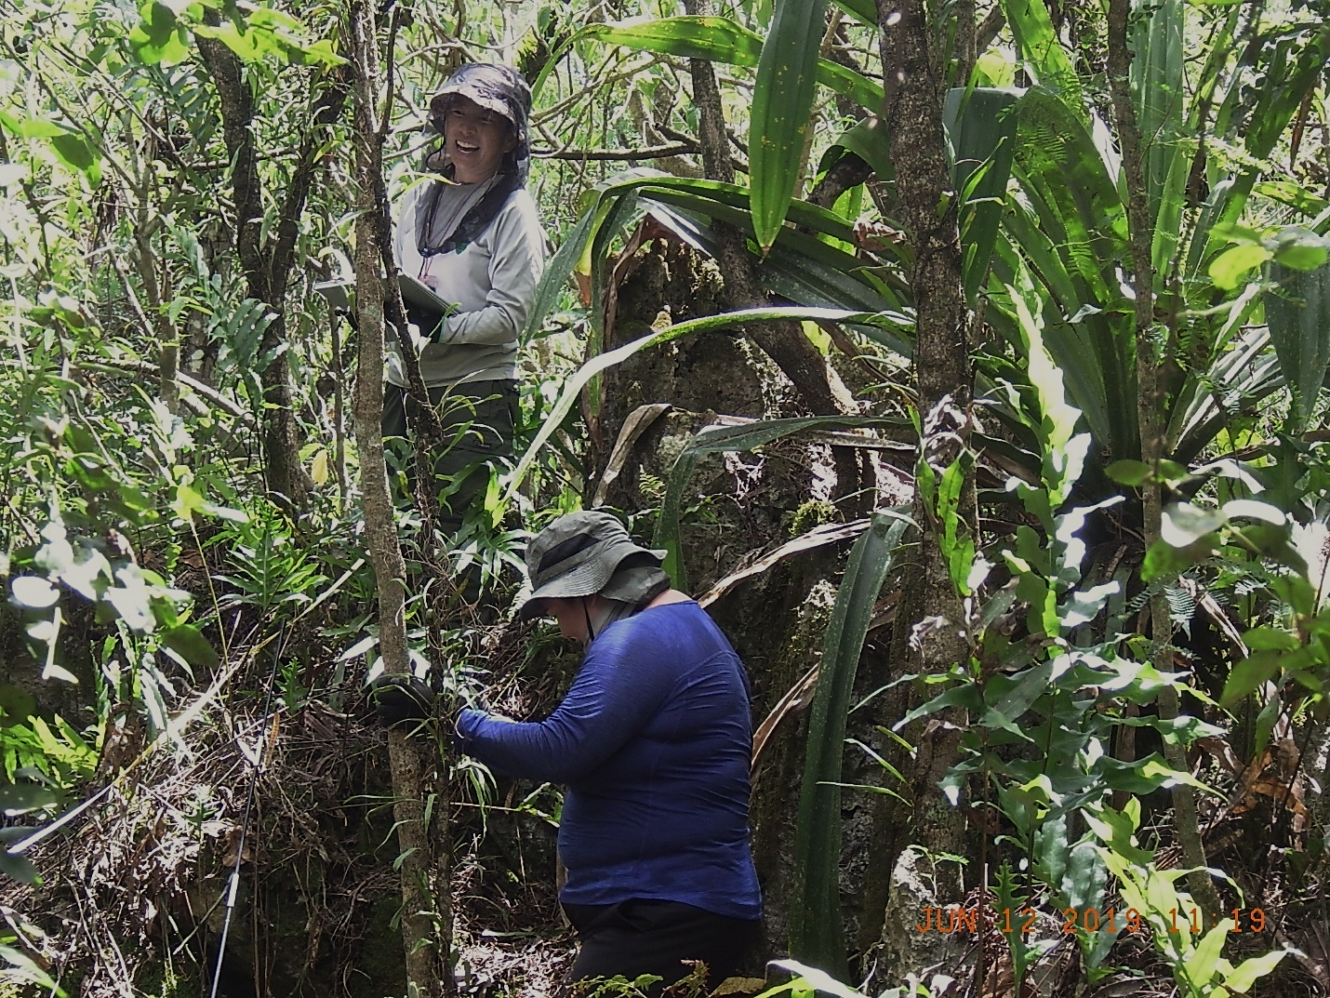
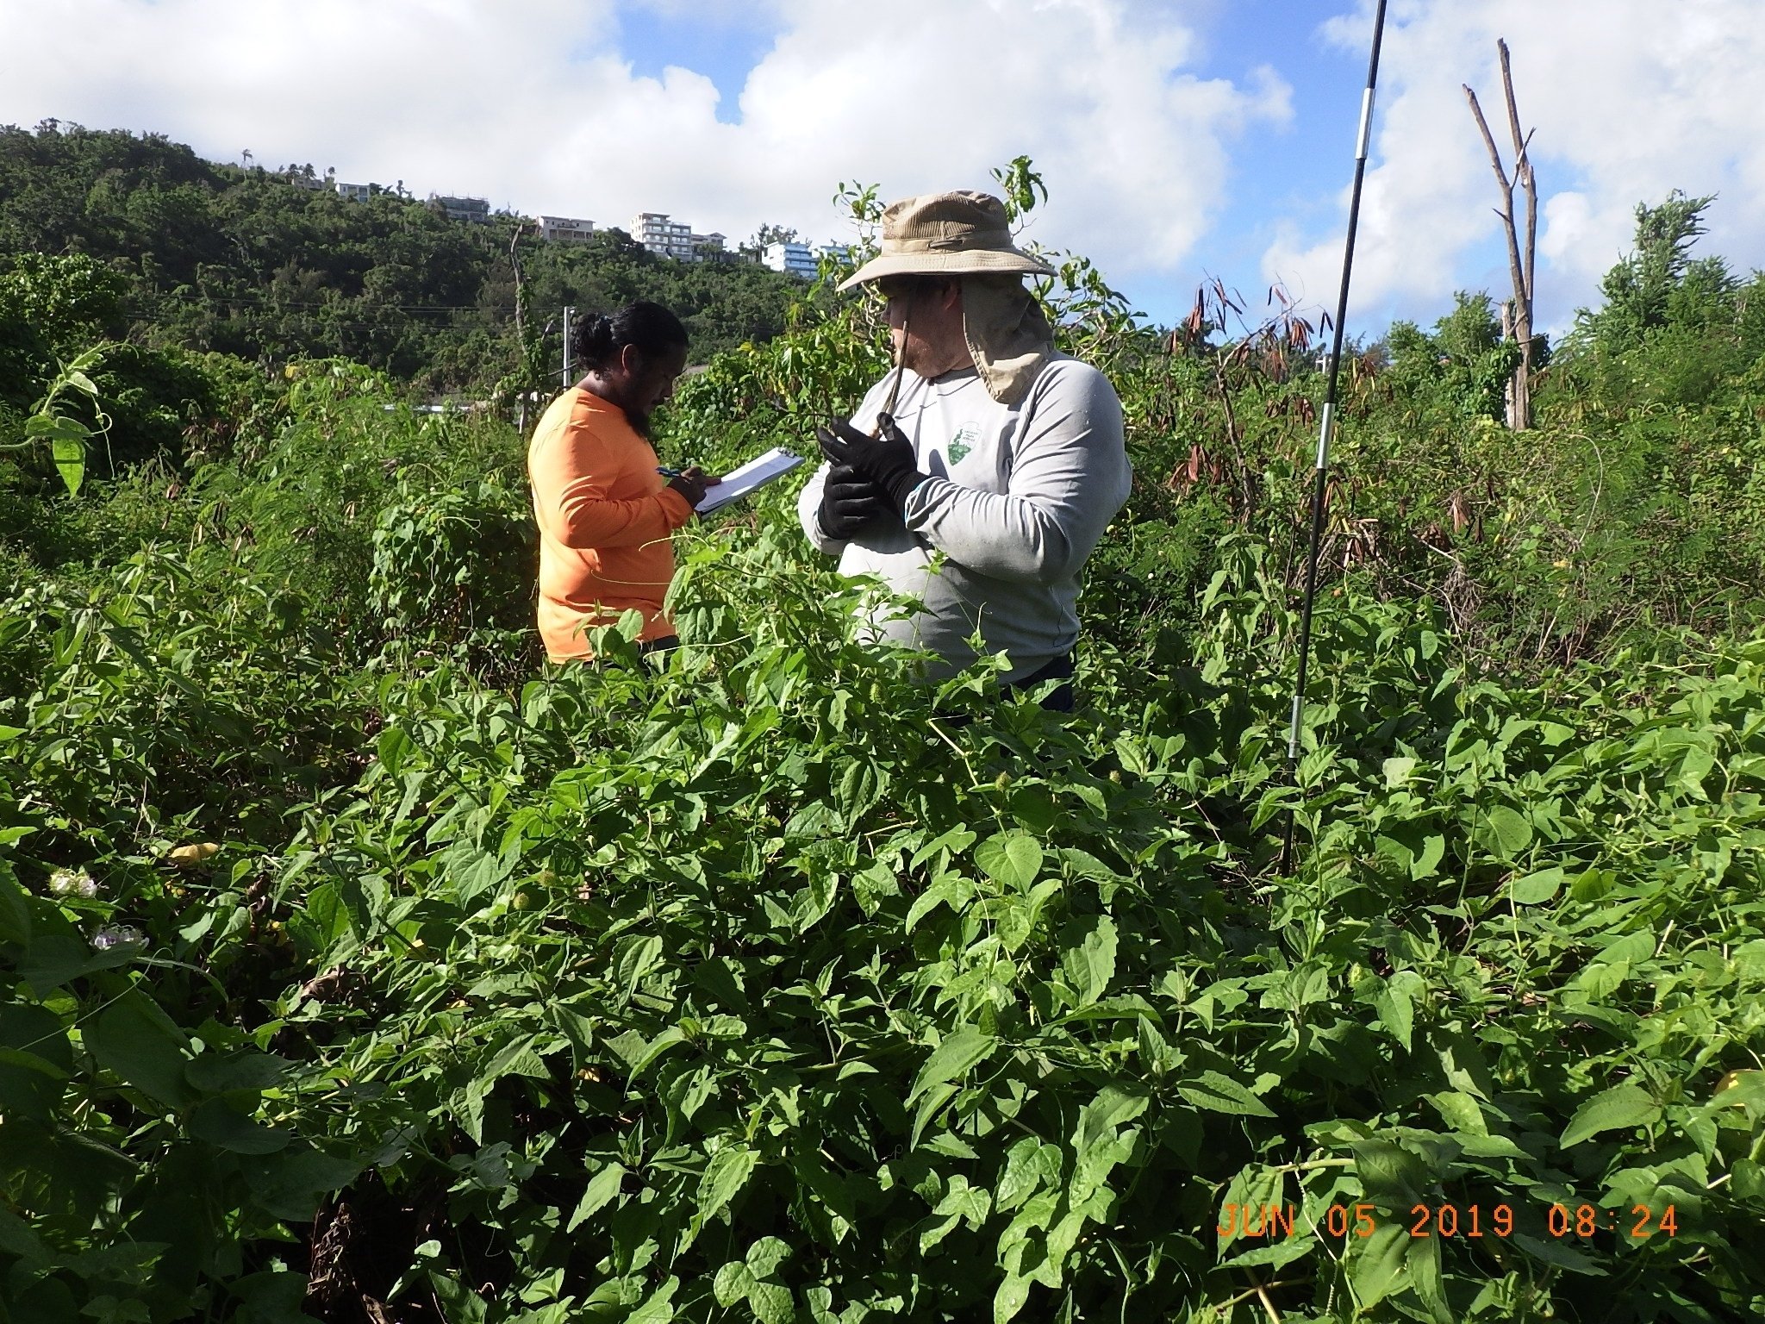
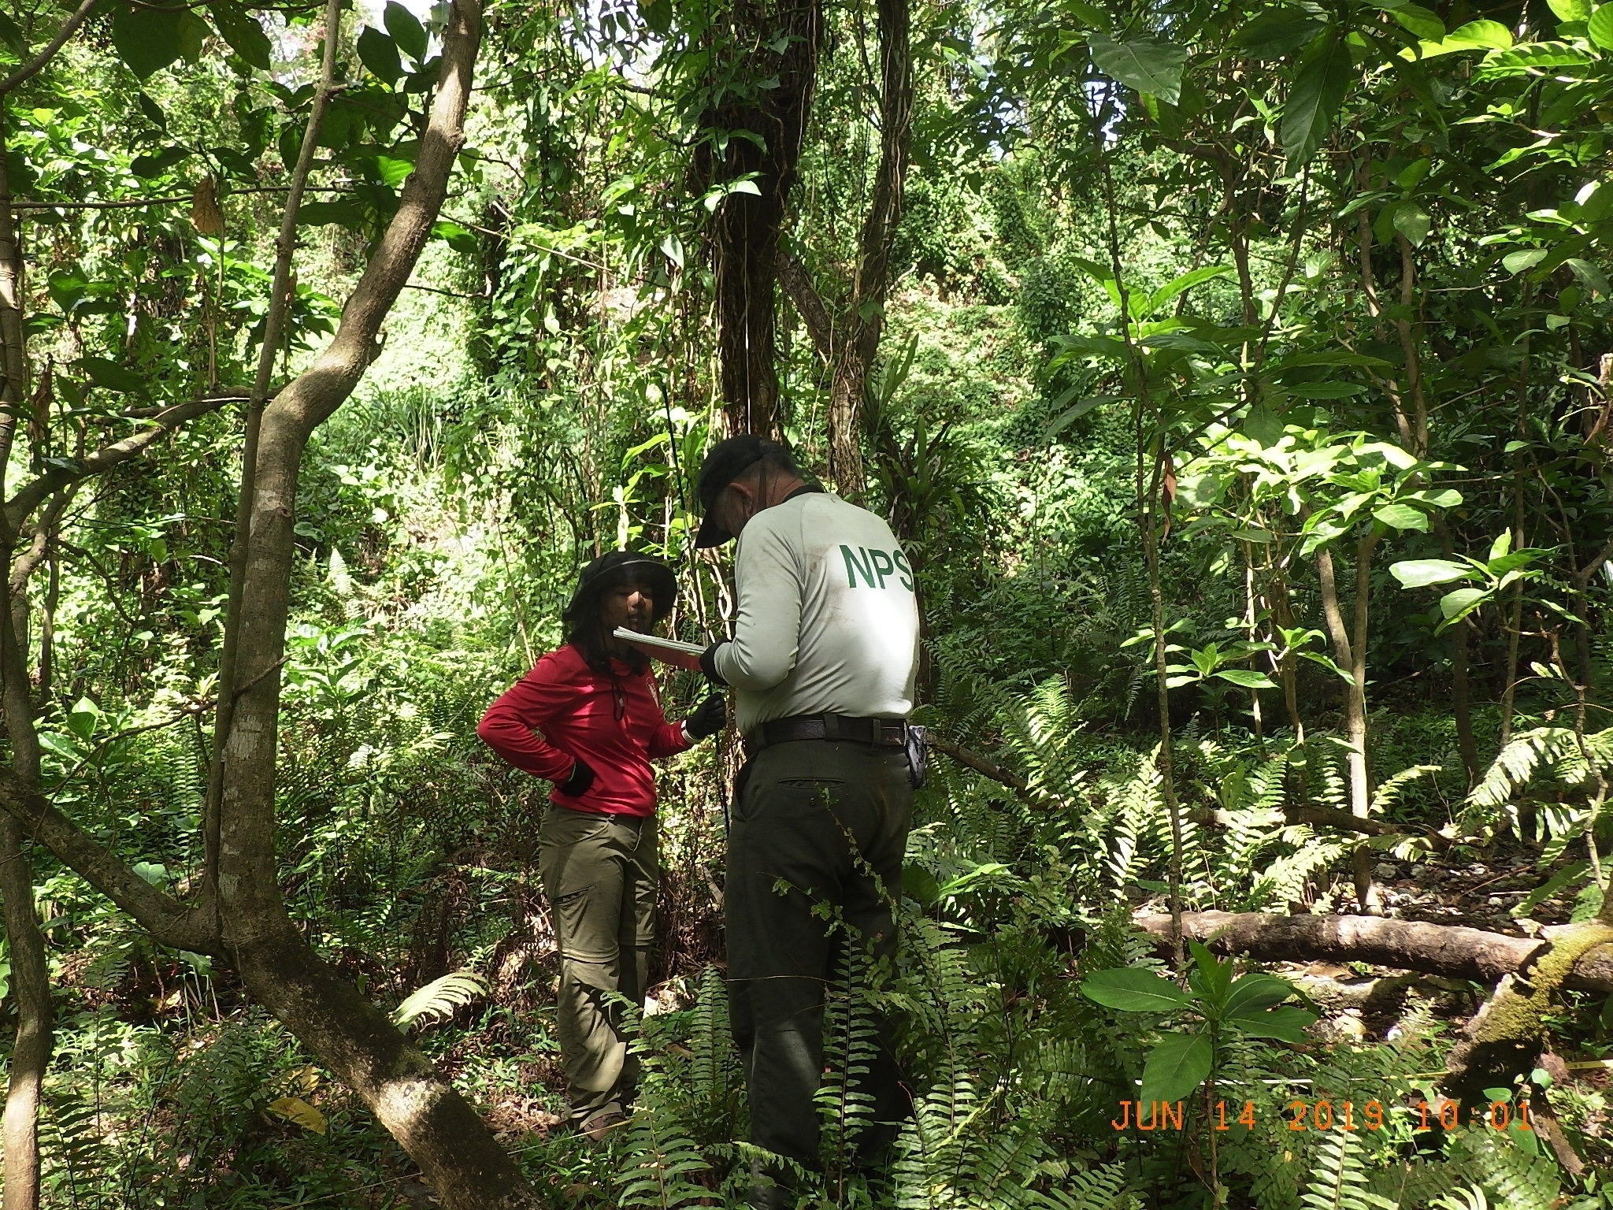
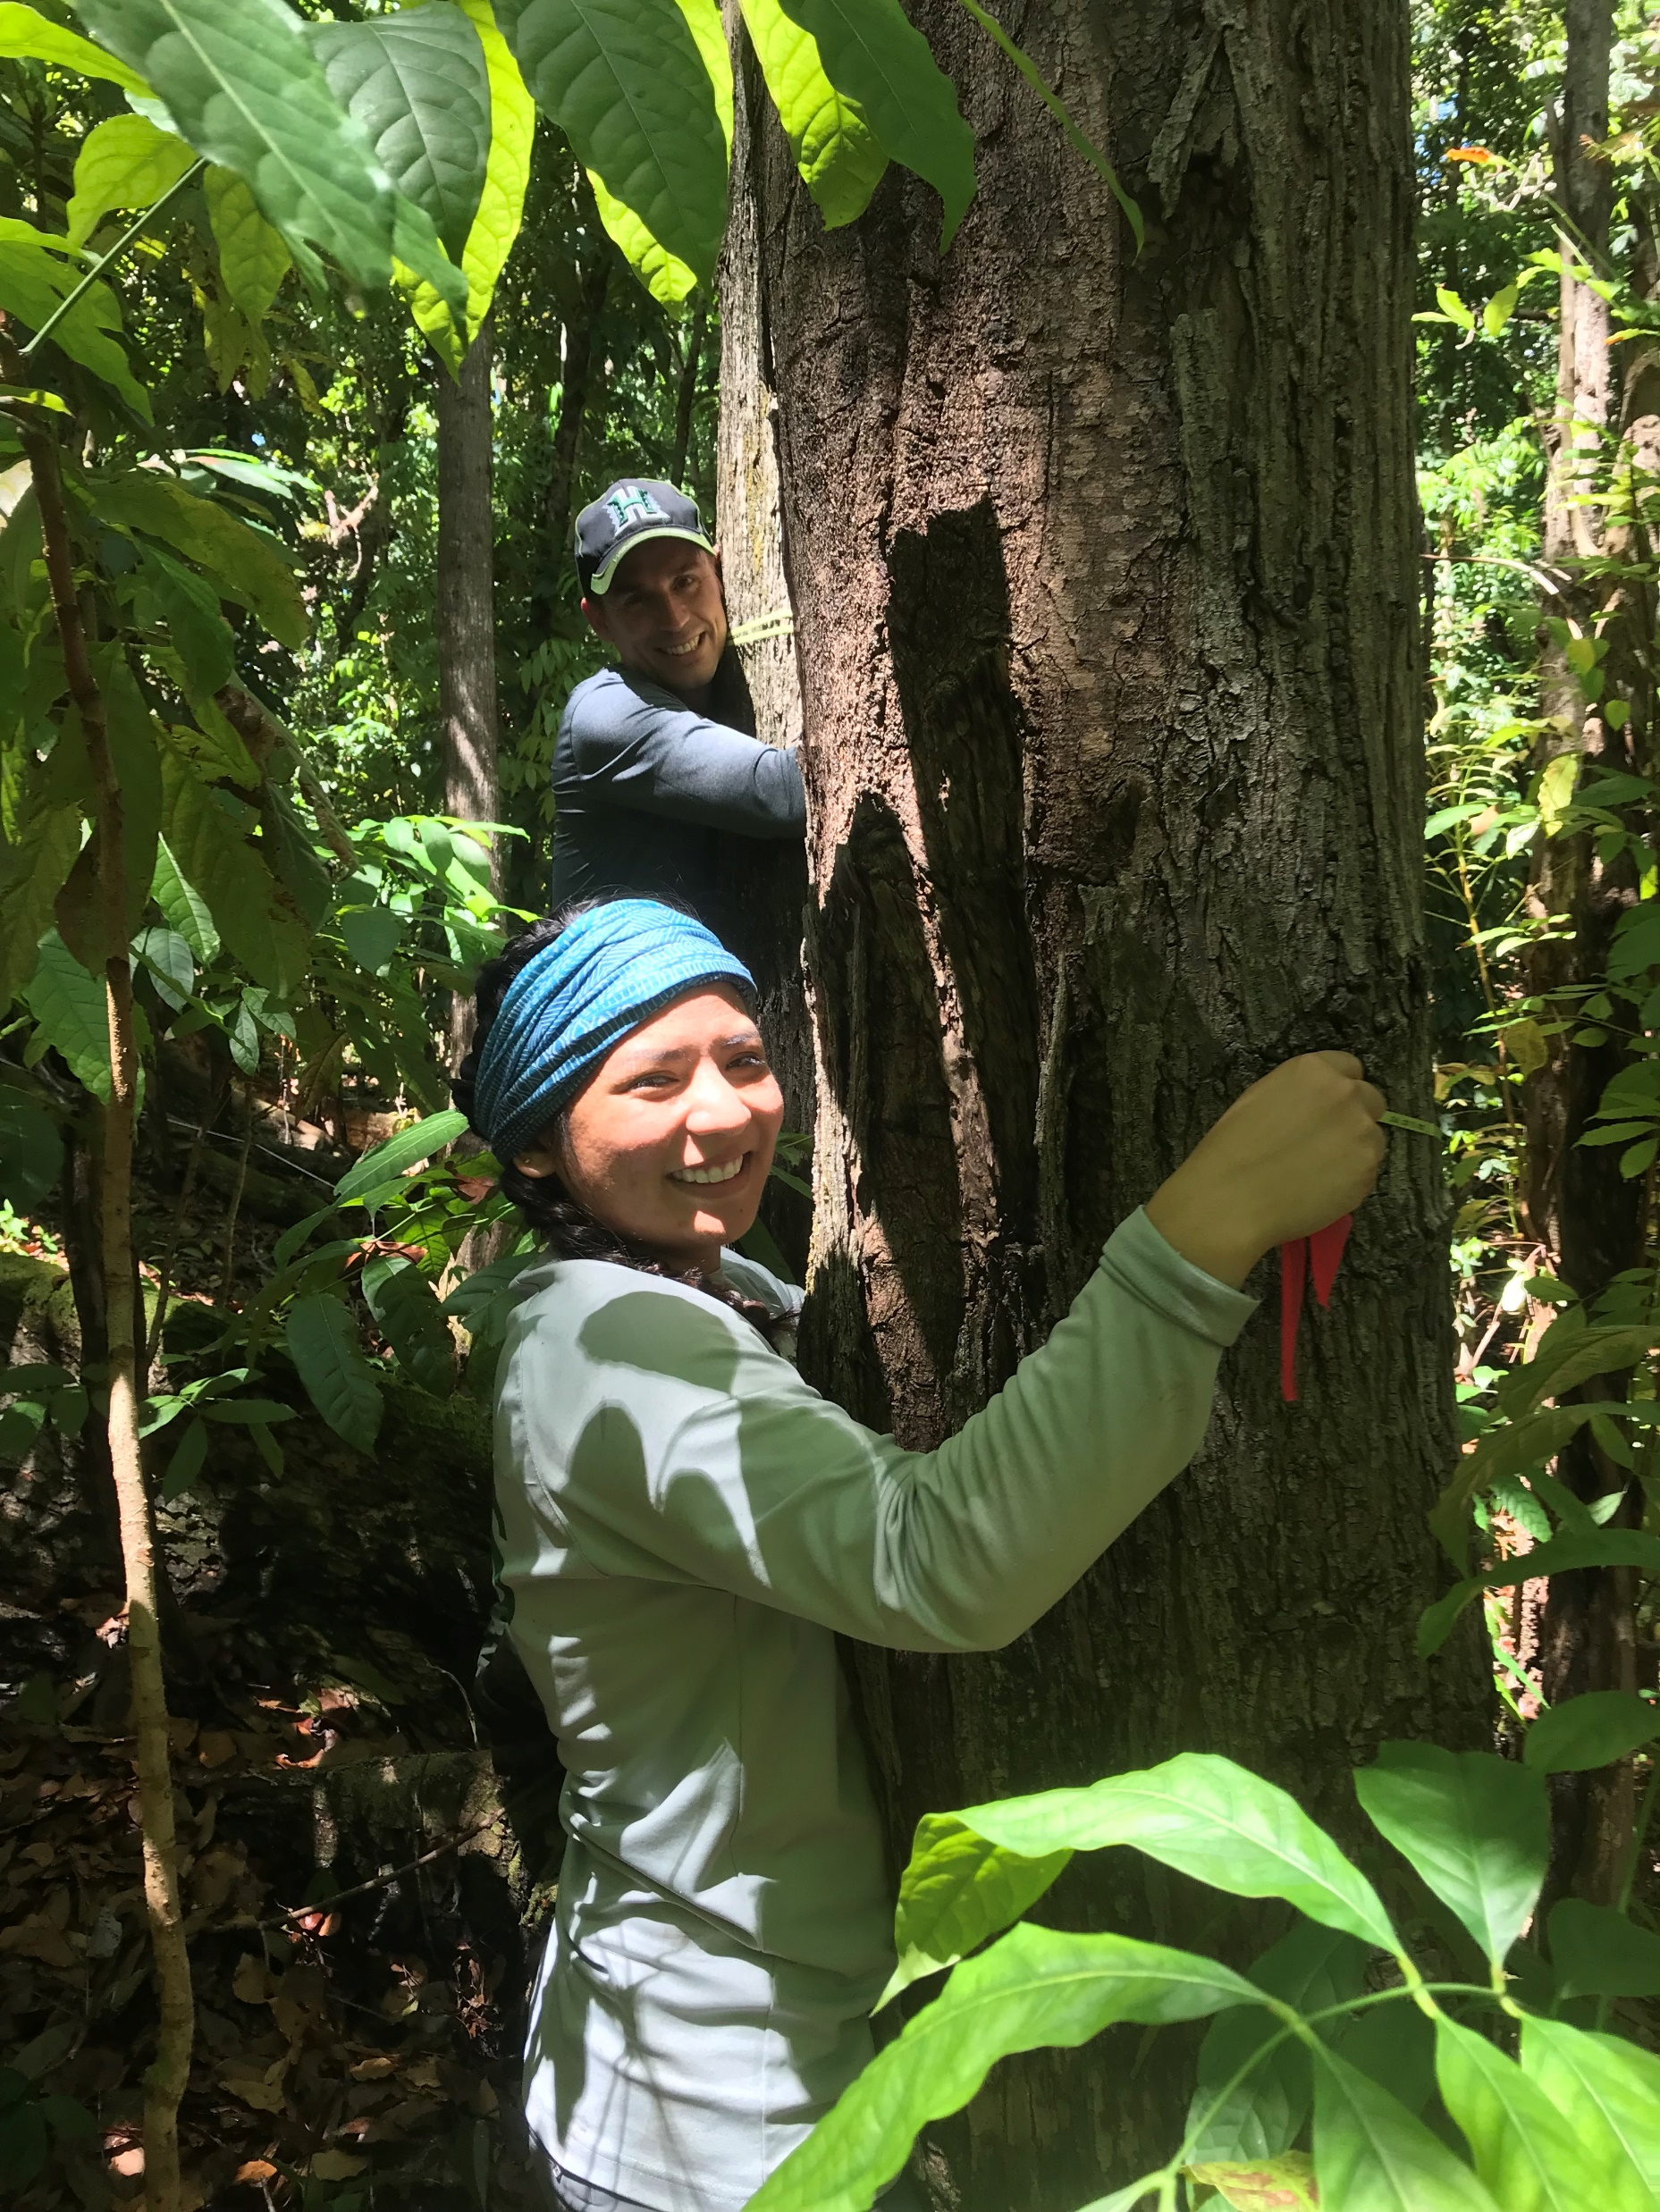
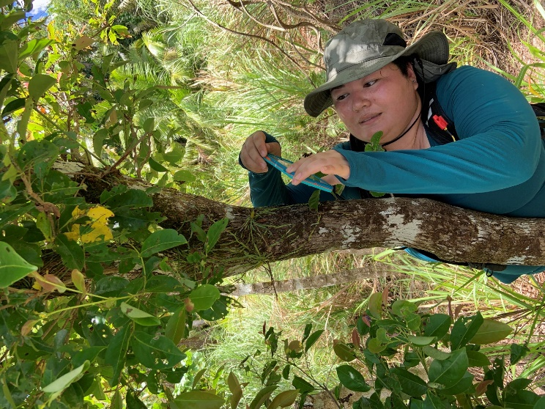
2019

Slide 30
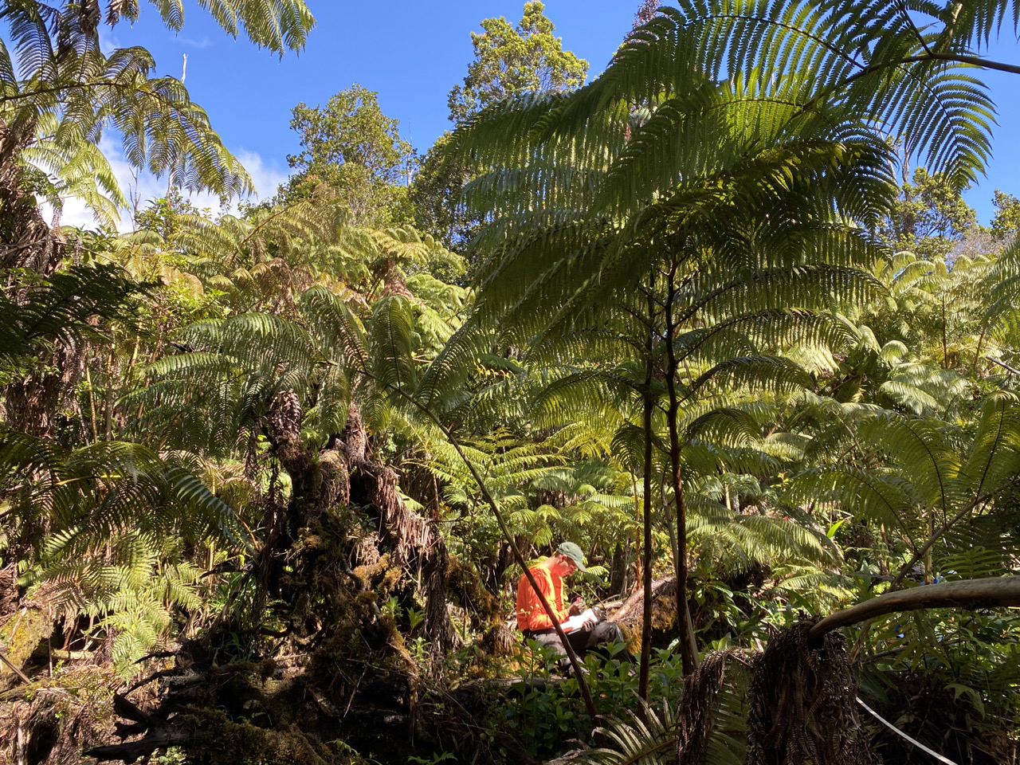
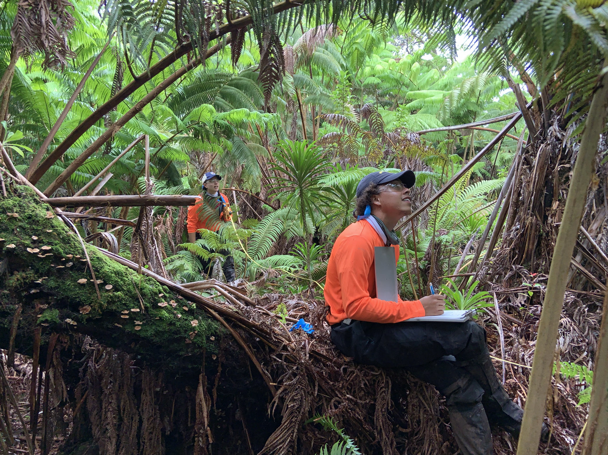
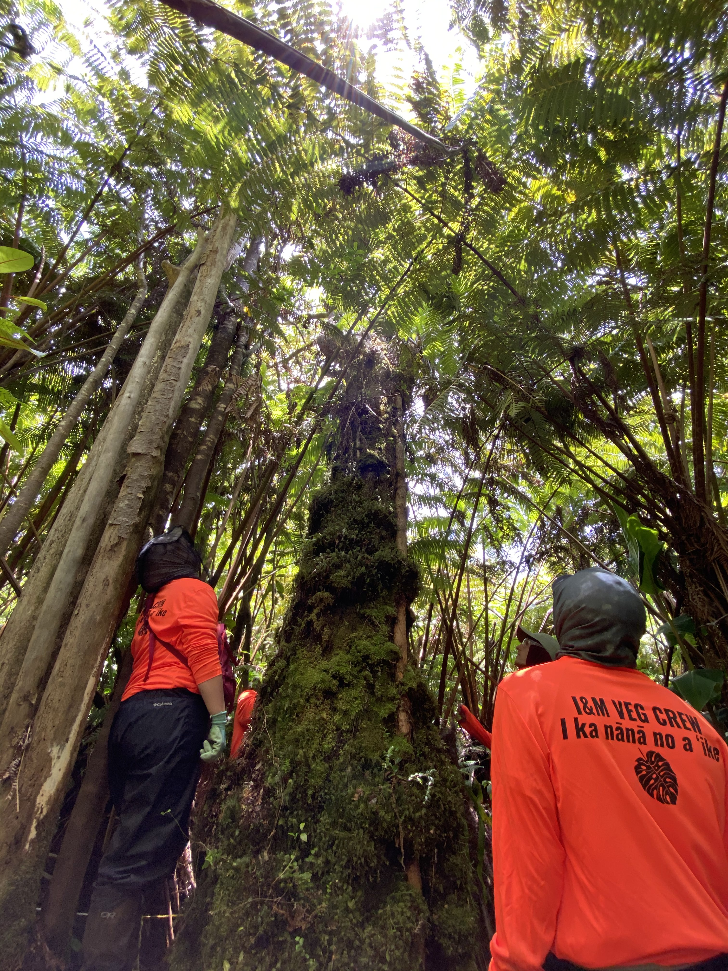
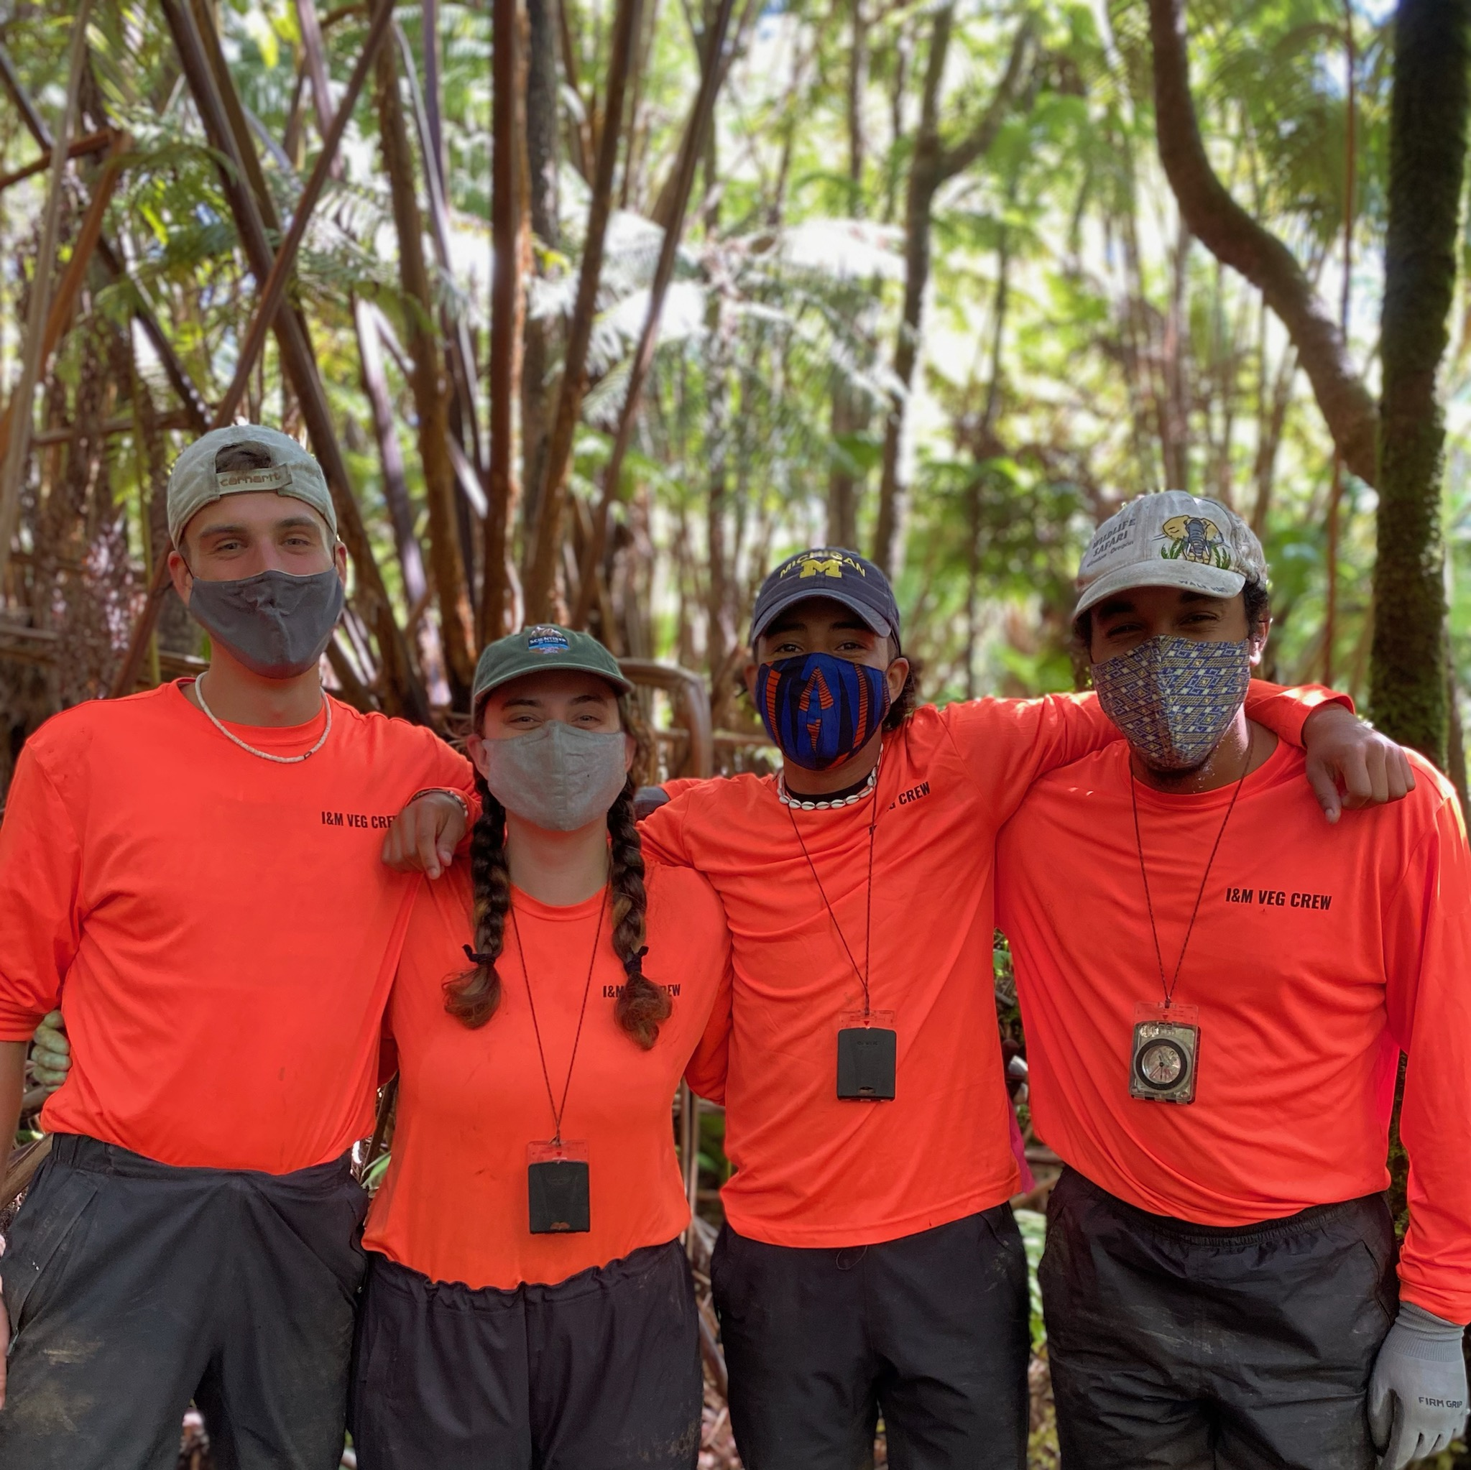
2021

Slide 31
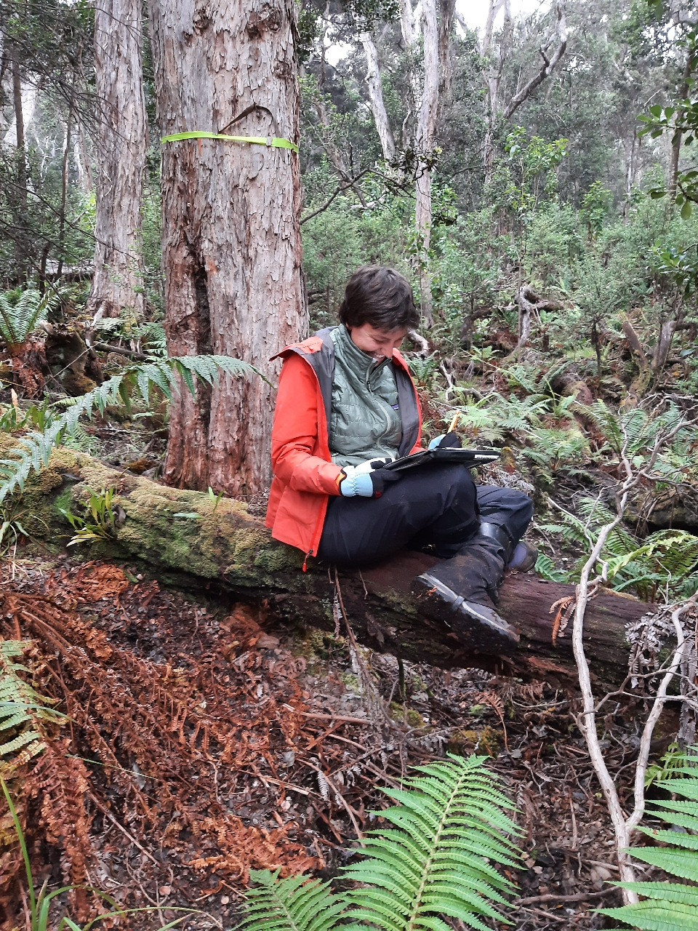
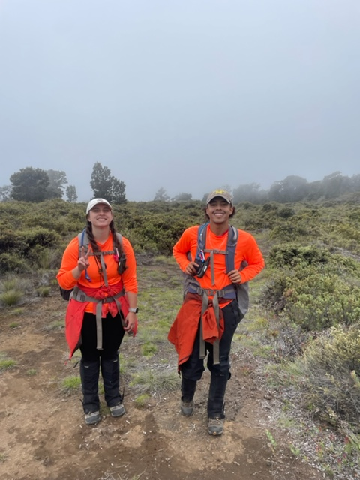
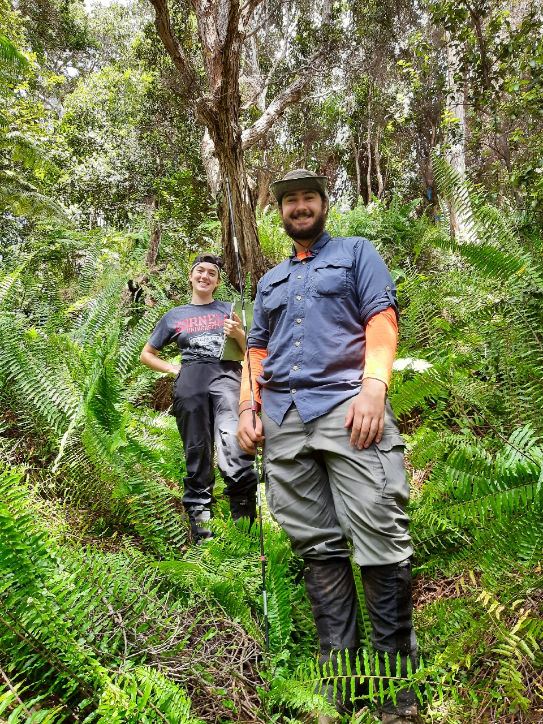
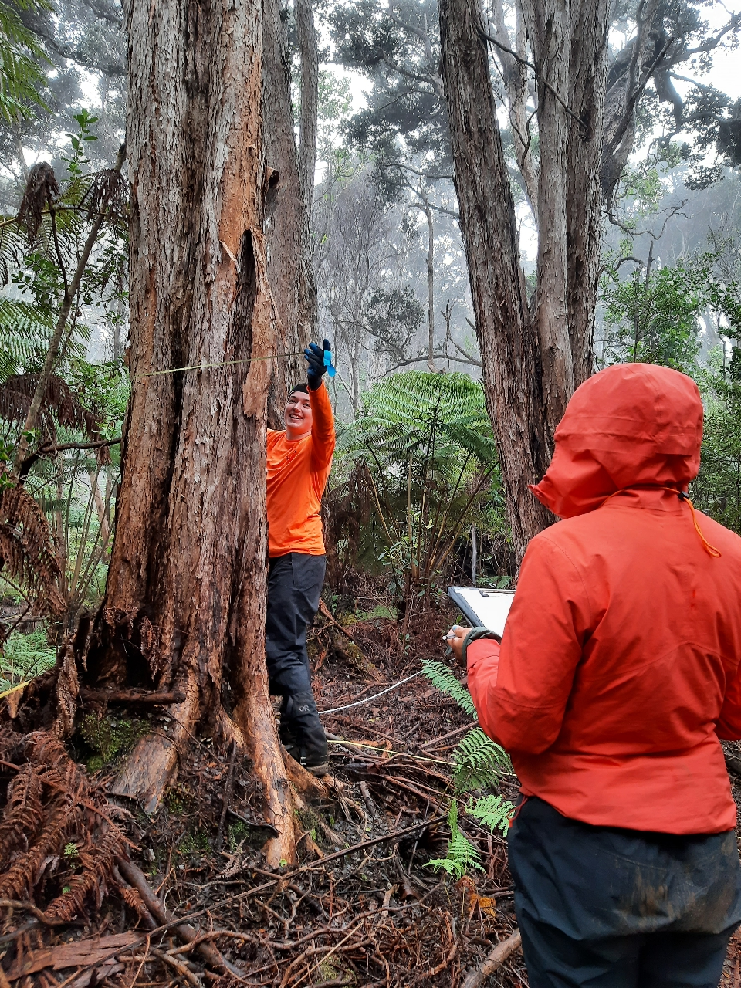
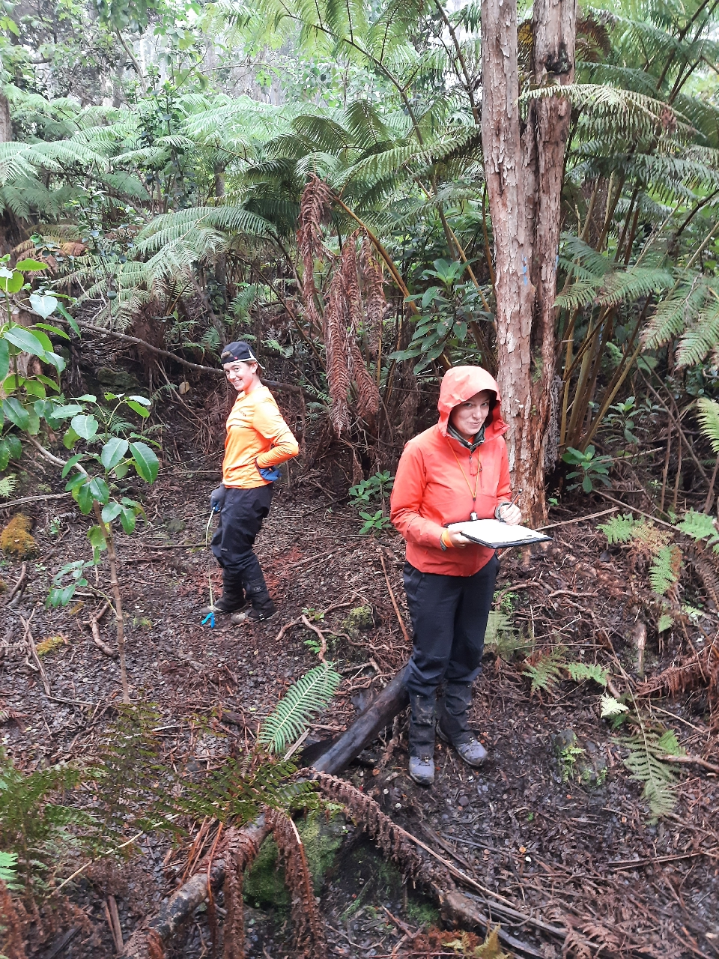
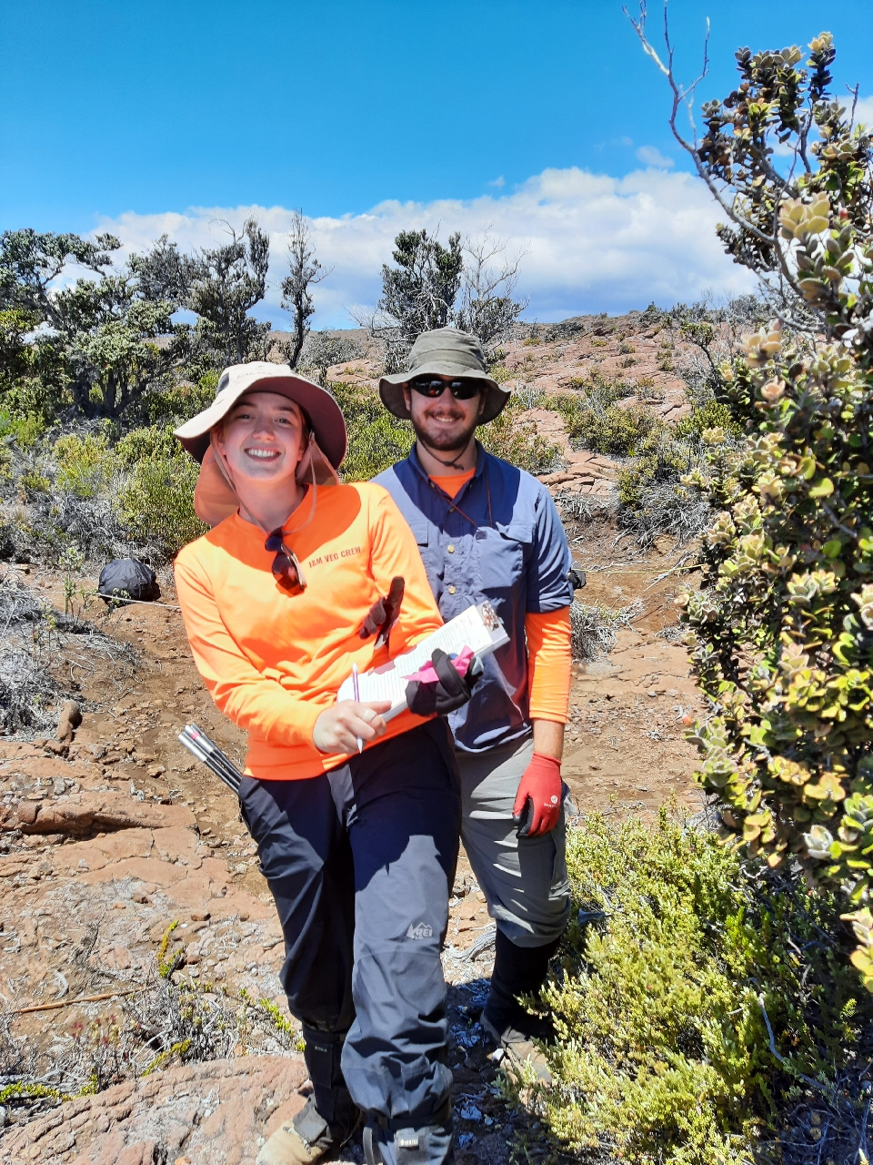
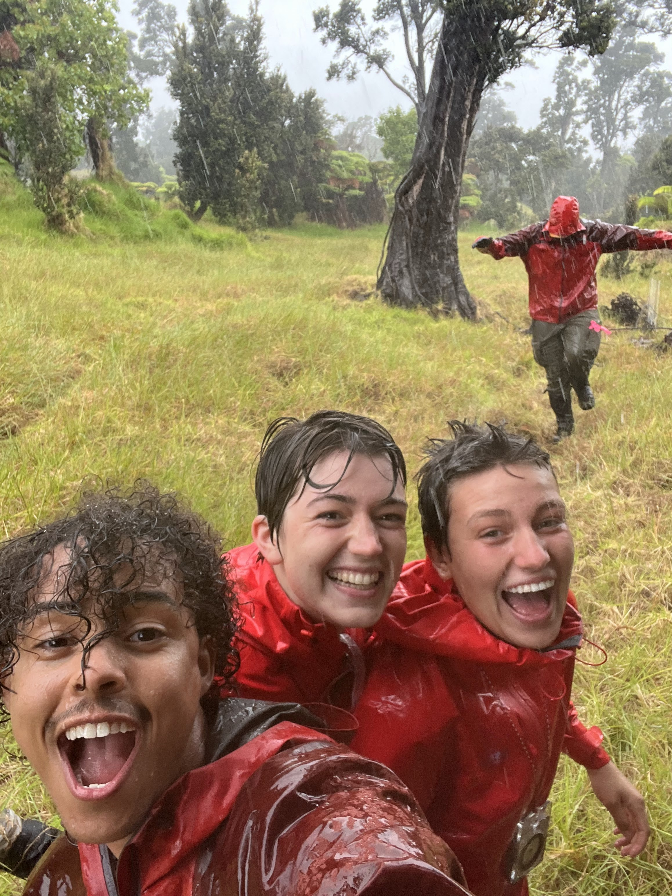
2022

Slide 32
2023 !!!!!!

Slide 33
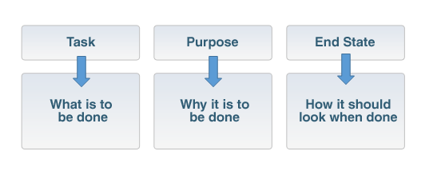
Kipahulu District
30 Plots (FTPC)
20 Transects (EIPS)
Objective Data Collection
Base-line Conditions (status)
Changes (trends)
Ecosystem Health
Early Warning
Inform Management
Datasheets scanned and backed up
Data in database
QA/QC (Accurate)
Reports
Briefings
Scientific Journals
Data dashboards
Haleakala Subalpine
30 Plots (FTPC)
20 Transects (EIPS)
Data Collected following established protocols & SOPs
Quality > Quantity

Slide 34
Priority #1:
Field work is conducted safely and respectively

